Slide 1
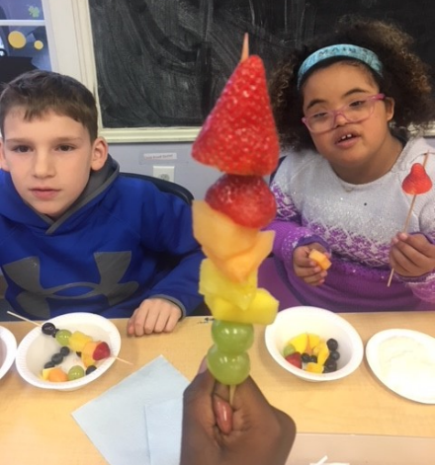
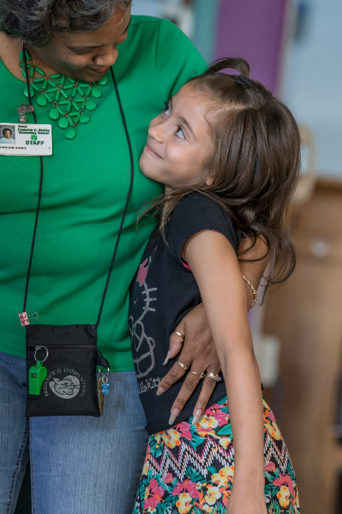
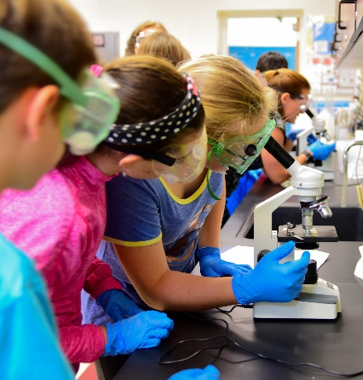
Governor’s Recommended CAPITAL BUDGET
March 2023
Notes:
Good afternoon Senator Walsh, Representative Heffernan, Bond Committee Members, Controller General Jones and staff. Thank you for the opportunity to present the Governor’s Recommended Fiscal Year 2024 Capital Budget for public education.
Let me introduce the members of my team joining me today: Associate Secretary for Operations Support Kim Klein, Finance Director Jenn Carlson, and Chief of Staff Meredith Seitz.
Before I turn it over to my team to walk you through the details, let me share the headline: Given existing funding pressures, we did not approve any requests for new projects in the Fiscal Year 2024 Capital Budget.
That doesn’t mean there aren’t needs. As many of you probably know from the schools in your own communities, many of our districts have pressing needs. But as we developed the public education capital budget request this year, our top priority was the $188.8 million necessary for previously authorized projects to ensure their continued progress toward completion. We also prioritized the $15.1 million for Minor Capital Improvement and Equipment (MCI) and Architectural Barrier Removal funding, which benefits public education statewide. That left no room for new projects.
We appreciate the disappointment of some of our district colleagues and recognize the challenges they are facing, and we hope that in future budget years, our request will be able to include some of those needs.
At this time, I would like to turn the presentation over to Jenn Carlson to walk you through the Governor’s Fiscal Year 2024 Recommended capital budget for public education.

Slide 2
Major Capital
5 Year Funding History
Fiscal Year | Amount*
2019 | $145,449.7
2020 | $145,505.9
2021 | $162,017.9
2022 | $229,358.0
2023 | $350,049.9
*Includes City of Wilmington Education Initiatives funded within OMB and Market Pressure.
Notes:
The 5 year funding history for major capital projects in public education has ranged from a high of $350.0 million in Fiscal Year 2023, to a low of $145.5 million in Fiscal Year 2019. These allocations include City of Wilmington Education Initiatives and Market Pressure but exclude Minor Capital, Architectural Barrier, and safety and security funds.

Slide 3
Minor Capital
5 Year Funding History
Fiscal Year | Amount
2019 | $15,000.0
2020 | $15,000.0
2021 | $13,545.1
2022 | $15,000.0
2023 | $30,000.0*
*Funding includes Enhanced MCI funds
Notes:
Over the same 5 year period, Minor Capital funding has ranged from $13.5 million in Fiscal Year 2021 to $30.0 million in Fiscal Year 2023 which included $15.0 million for Enhanced MCI. It is important to note that additional funds to this appropriation help alleviate the growing statewide maintenance pressures that result from aging school buildings. LEAs are also able to utilize these funds to address lead remediation efforts. These allocations do not include the $160,000 received each year for Architectural Barrier issues.

Slide 4
FY24 State Funding Summary
 | FY24 Governor’s Recommended Budget | Balance Remaining (out years)
Ongoing Projects | $72,314.1 | $144,596.2
100% State Funded Ongoing Projects (includes City of Wilmington Education Initiatives Project) | $21,682.1 | $47,455.0
Market Pressure Contingency | $97,787.3 | TBD
Minor Capital Improvements | $15,000.0 | On-going
Architectural Barrier Removal | $160.0 | On-going
Safety and Security | $9,138.0 | TBD
TOTAL | $216,081.5 | $192,051.2
Notes:
The Governor’s Recommended Fiscal Year 2024 Capital Budget includes just under $216.1 million for public education funding for ongoing projects, including 100 percent state funded projects, market pressure contingency, minor capital improvements, architectural barrier removal and Safety and Security Funding. There is also $1 million of Safety and Security funding allocated in the operating budget to address operational needs. Please note that funding for the new Bancroft elementary school in Wilmington is recommended within the Office of Management and Budget.

Slide 5
Ongoing Projects
 | FY24 Governor’s Recommended Budget | Balance Remaining (out years)
Appoquinimink, Louis L. Redding | $30,668.3 | -
NCCVT, Hodgson Replacement | $3,000.0 | $50,263.4
Sussex Tech, New Sussex Tech High School | $36,645.8 | $44,935.2
Milford, Middle School Revitalization | $2,000.0 | -
Smyrna, N. Smyrna Addition/Renovation* | - | $24,770.7
Smyrna, 600 Student Elementary School* | - | $6,800.6
Smyrna, Clayton Intermediate Addition* | - | $17,826.3
TOTAL | $72,314.1 | $144,596.2
*Smyrna FY24 project funding was allocated in FY23.
Notes:
Ongoing projects represented on this slide are those projects that were funded in previous fiscal year bond bills. The Governor’s Recommended Budget allocation for ongoing projects is a little over $72 million dollars with a remaining State obligation of approximately $145 million for out-year funding.

Slide 6
Ongoing Projects
100% State Funded
 | FY24 Governor’s Recommended Budget | Balance Remaining (out years)
City of Wilmington Education Initiatives* | $12,666.4
Brandywine, Bush School (FY24 Estimate) | $8,200.0 | $10,000.0
Colonial, New Leach School | $815.7 | $37,455.0
TOTAL | $21,682.1 | $47,455.0
*Funding is allocated in the Office of Management and Budget.
Notes:
The Governor’s Recommended Budget allocation for 100% State funded projects, both new and ongoing, is over $21 million dollars and there will be a remaining State obligation of over $47 million for out-year funding.

Slide 7
Lead Sampling Update
14 school districts and charter schools have been completed to date.
All schools are anticipated to be completed by the end of May.
Results available on de.gov/schoolwater
Over 75% of samples are considered below the detection limit of 2 ppb.
Schools are actively working on immediate and long-term risk reduction strategies
Notes:
The lead sampling effort has been completed in 10 school districts and 4 charter schools including: Indian River, Colonial, Capital, Smyrna, Sussex Tech, Polytech, NCCVT, Seaford, Delmar, Woodbridge, MOT, Campus Community School, Freire and Thomas Edison charter schools.
The project is progressing well and is expected to be completed in May. The schedule is updated regularly and is posted on de.gov/schoolwater website, along with sampling results as they are completed.
Results so far indicate that there is not a widespread problem in Delaware schools, but is identifying specific points and areas that need attention to reduce lead risk and exposure. Currently, over 75% of the results are either non-detect or below the laboratory reporting limit of 2 parts per billion.
DOE and Public Health are working collaboratively with our school districts and charter schools and providing technical guidance, communications support and other help as needed.
The immediate strategies being employed by schools to reduce risk and exposure include shutting off fixtures, signage for non-consumption points and providing alternate water sources. The long-term strategies to address lead exposures include fixture removal, replacement and filtration. As mentioned previously, school districts and charter schools may utilize local funds, as well as MCI and enhanced MCI for lead remediation efforts.
Note: Mark may mention the filter first request of $3.8M, which would provide an allocation to each school to support installation of bottle fillers, kitchen faucets and other fixtures with filtration.

Slide 8
questions?
Notes:
That concludes our formal presentation. I would like to turn it back over to Secretary Holodick.

