Slide 1
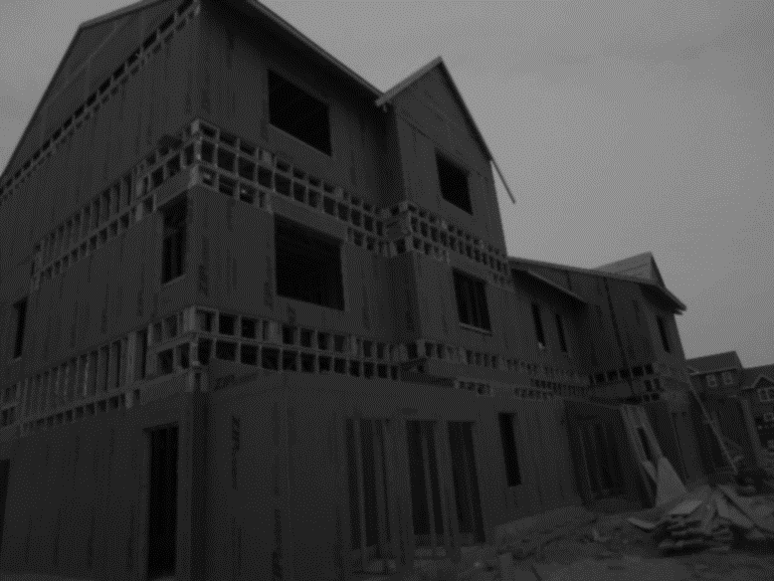
DEVELOPING DELAWARE
FY 2024 Capital Improvement Committee Presentation
Delaware State Housing Authority
March 24, 2023
Notes:
Good morning and thank you for the opportunity to share DSHA’s Fiscal Year 2024 Capital Improvement budget request. I am Eugene R. Young Jr., Director of the Delaware State Housing Authority.
First, I’d like to introduce the DSHA’s co-deputies, who are present here today:
-Cynthia Karnai
-Susan Eliason
And I’d like to recognize our agency staff and Council on Housing members for joining virtually.
Affordable housing is an utmost priority for our Governor. Our state's demand for quality, safe, economical housing has skyrocketed.
This is a fact that DSHA is well aware of, and thanks to many of you here today, an issue we're addressing on multiple levels using the agency’s state and federal resources.
For the next few minutes, I will cover how our Fiscal Year 2024 capital improvement budget request supports the agency’s focus on developing Delaware and, more importantly, helping more families find a safe, affordable place to call home.

Slide 2
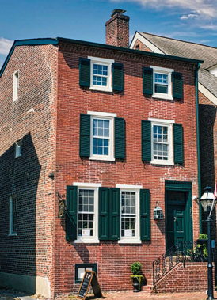
ABOUT DELAWARE STATE HOUSING AUTHORITY
Our mission is to efficiently provide, and to assist others to provide quality, affordable housing opportunities and appropriate supportive services to low- and moderate-income Delawareans.
Core DSHA Services:
Homeownership
Rental Housing
Affordable Housing & Community Development
Notes:
First, I’ll begin with some background on our agency. Created in 1968, our mission is to efficiently provide, and to assist others to provide quality, affordable housing opportunities and appropriate supportive services to low- and moderate-income Delawareans.
DSHA serves as the state's housing finance agency and has the power to make loans or grants to various stakeholders and requires that they use the proceeds to make new residential homeownership opportunities available to Delawareans.
A DSHA mortgage is a 30-year, fixed-rate loan with interest rates at or below the standard market rate for qualified buyers. We offer down payment and closing cost assistance through our Preferred Plus program.
We also offer other programs for homeowners, including foreclosure prevention, home repair, and rehab programs.
In addition to serving as the state’s housing finance agency, DSHA is unique in that it serves as a public housing authority and community development agency.
Our agency owns and operates public housing in Kent and Sussex County as well as takes pride in providing sources of financing for housing and economic development.

Slide 3
DEVELOPING DELAWARE
General Fund:
Housing Development Fund (HDF) | $4,000,000
State Rental Assistance Program (SRAP) | $4,000,000
Total General Fund: | $8,000,000
Bond Bill:
Affordable Rental Housing Program (ARHP) | $6,000,000
Downtown Development Districts (DDD) | $5,500,000
Strong Neighborhoods Housing Fund (SNHF) | $4,000,000
Total Bond Bill: | $15,500,000
DSHA Budget Request | $23,500,000
*Not inclusive of one-time $30,000,000 supplement
Notes:
DSHA is primarily funded through the private market (about 74%), the federal government (about 10%), and state government (about 10%), which brings us to our budget request today.
We are here before you seeking:
$6 million for our Affordable Rental Housing Program
$5.5 million for our Downtown Development Districts, also known as DDD
$4 million for our Strong Neighborhoods Housing Fund
Recently, an additional $30 million in one-time supplemental funds were announced for housing initiatives. This funding is not included in the chart and will be allocated through the general fund. Nevertheless, it should be celebrated and recorded.

Slide 4
AFFORDABLE RENTAL HOUSING PROGRAM & HOUSING DEVELOPMENT FUND
How It Works:
How Much:
Federal Low-Income Housing Tax Credit (LIHTC)
LIHTC equity is used to finance the construction
ARHP and HDF reduce the amount of first debt, which leads to more affordable rents
In FY22, ARHP and HDF invested approximately $9.6 million, which leveraged $21 million in LIHTC equity
ARHP and HDF also leveraged about $20 million in private investment and other funding sources
Notes:
Our Affordable Rental Housing Program, referred to as ARHP, works mainly in conjunction with our state and federal funds.
For instance, our Low-Income Housing Tax Credit (LIHTC) finances a construction project. Then, our ARHP and Housing Development Fund (HDF) reduce the first debt amount, leading to more affordable rent prices.
Last year, ARHP and HDF invested approximately $9.6 million, which leveraged $21 million in LIHTC equity.
Additionally, ARHP and HDF also leveraged about $20 million in private investment and other funding.

Slide 5
KENT COUNTY: DE BOND I
ARHP & HDF (State Financing): $6,320,000
Federal Funding: $1,050,000
Total Development Cost:
$14,188,008
Private Funding: $4,248,546
LIHTC Equity: $2,569,462
Notes:
DE Bond I is the preservation of Smyrna Gardens in Smyrna and East Lake Apartments in Dover under a 4% tax exempt bond issue
The project involved rehabbing 118 units for families at or below 60% AMI. Rent limits will apply and housing vouchers will be accepted.
This is an example of how DSHA is able to preserve units that have common ownership, even if they are not contiguous

Slide 6
NEW CASTLE COUNTY: FLATS, PHASE IV
ARHP & HDF (State Financing): $1,020,000
Federal Funding: $4,239,526
Total Development Cost:
$17,007,136
Private Funding: $1,100,000
LIHTC Equity: $10,647,610
Notes:
The Flats Phase 4 is located in Wilmington and is under construction now.
It will produce 52 units that range from 1 bedroom to 3 bedrooms.
Income limits will apply, and section 8 vouchers will be accepted, while rent will range from $300 to $1,200.

Slide 7
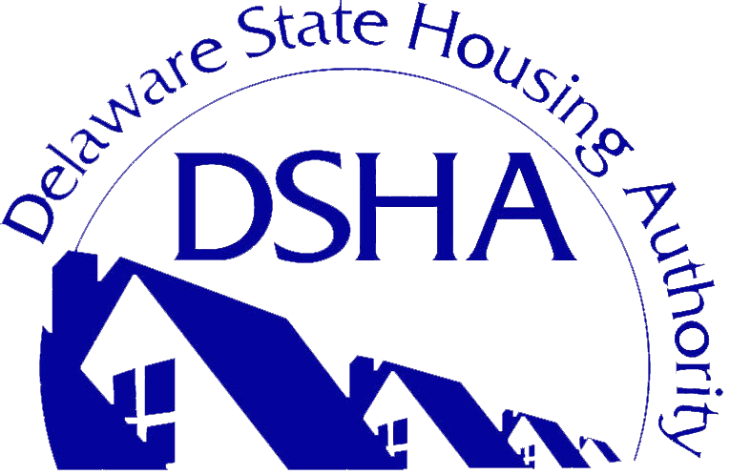
DEVELOPING DELAWARE DOWNTOWN DEVELOPMENT DISTRICTS
Created by legislation and passed unanimously in May 2014 by the General Assembly
Catalyzes private investment, stimulates job growth, and builds a stable community of long-term residents
$5,500,000 REQUESTED
Notes:
Up next, we have our DDD program. It was created in 2014 to provide a rebate to Qualified District Investors who make a Qualified Real Property Investment within designated districts. The projects must be completed before applying for funds
We thank our partners statewide for stepping in to design additional resources and incentives that help maximize the impact of this program.

Slide 8
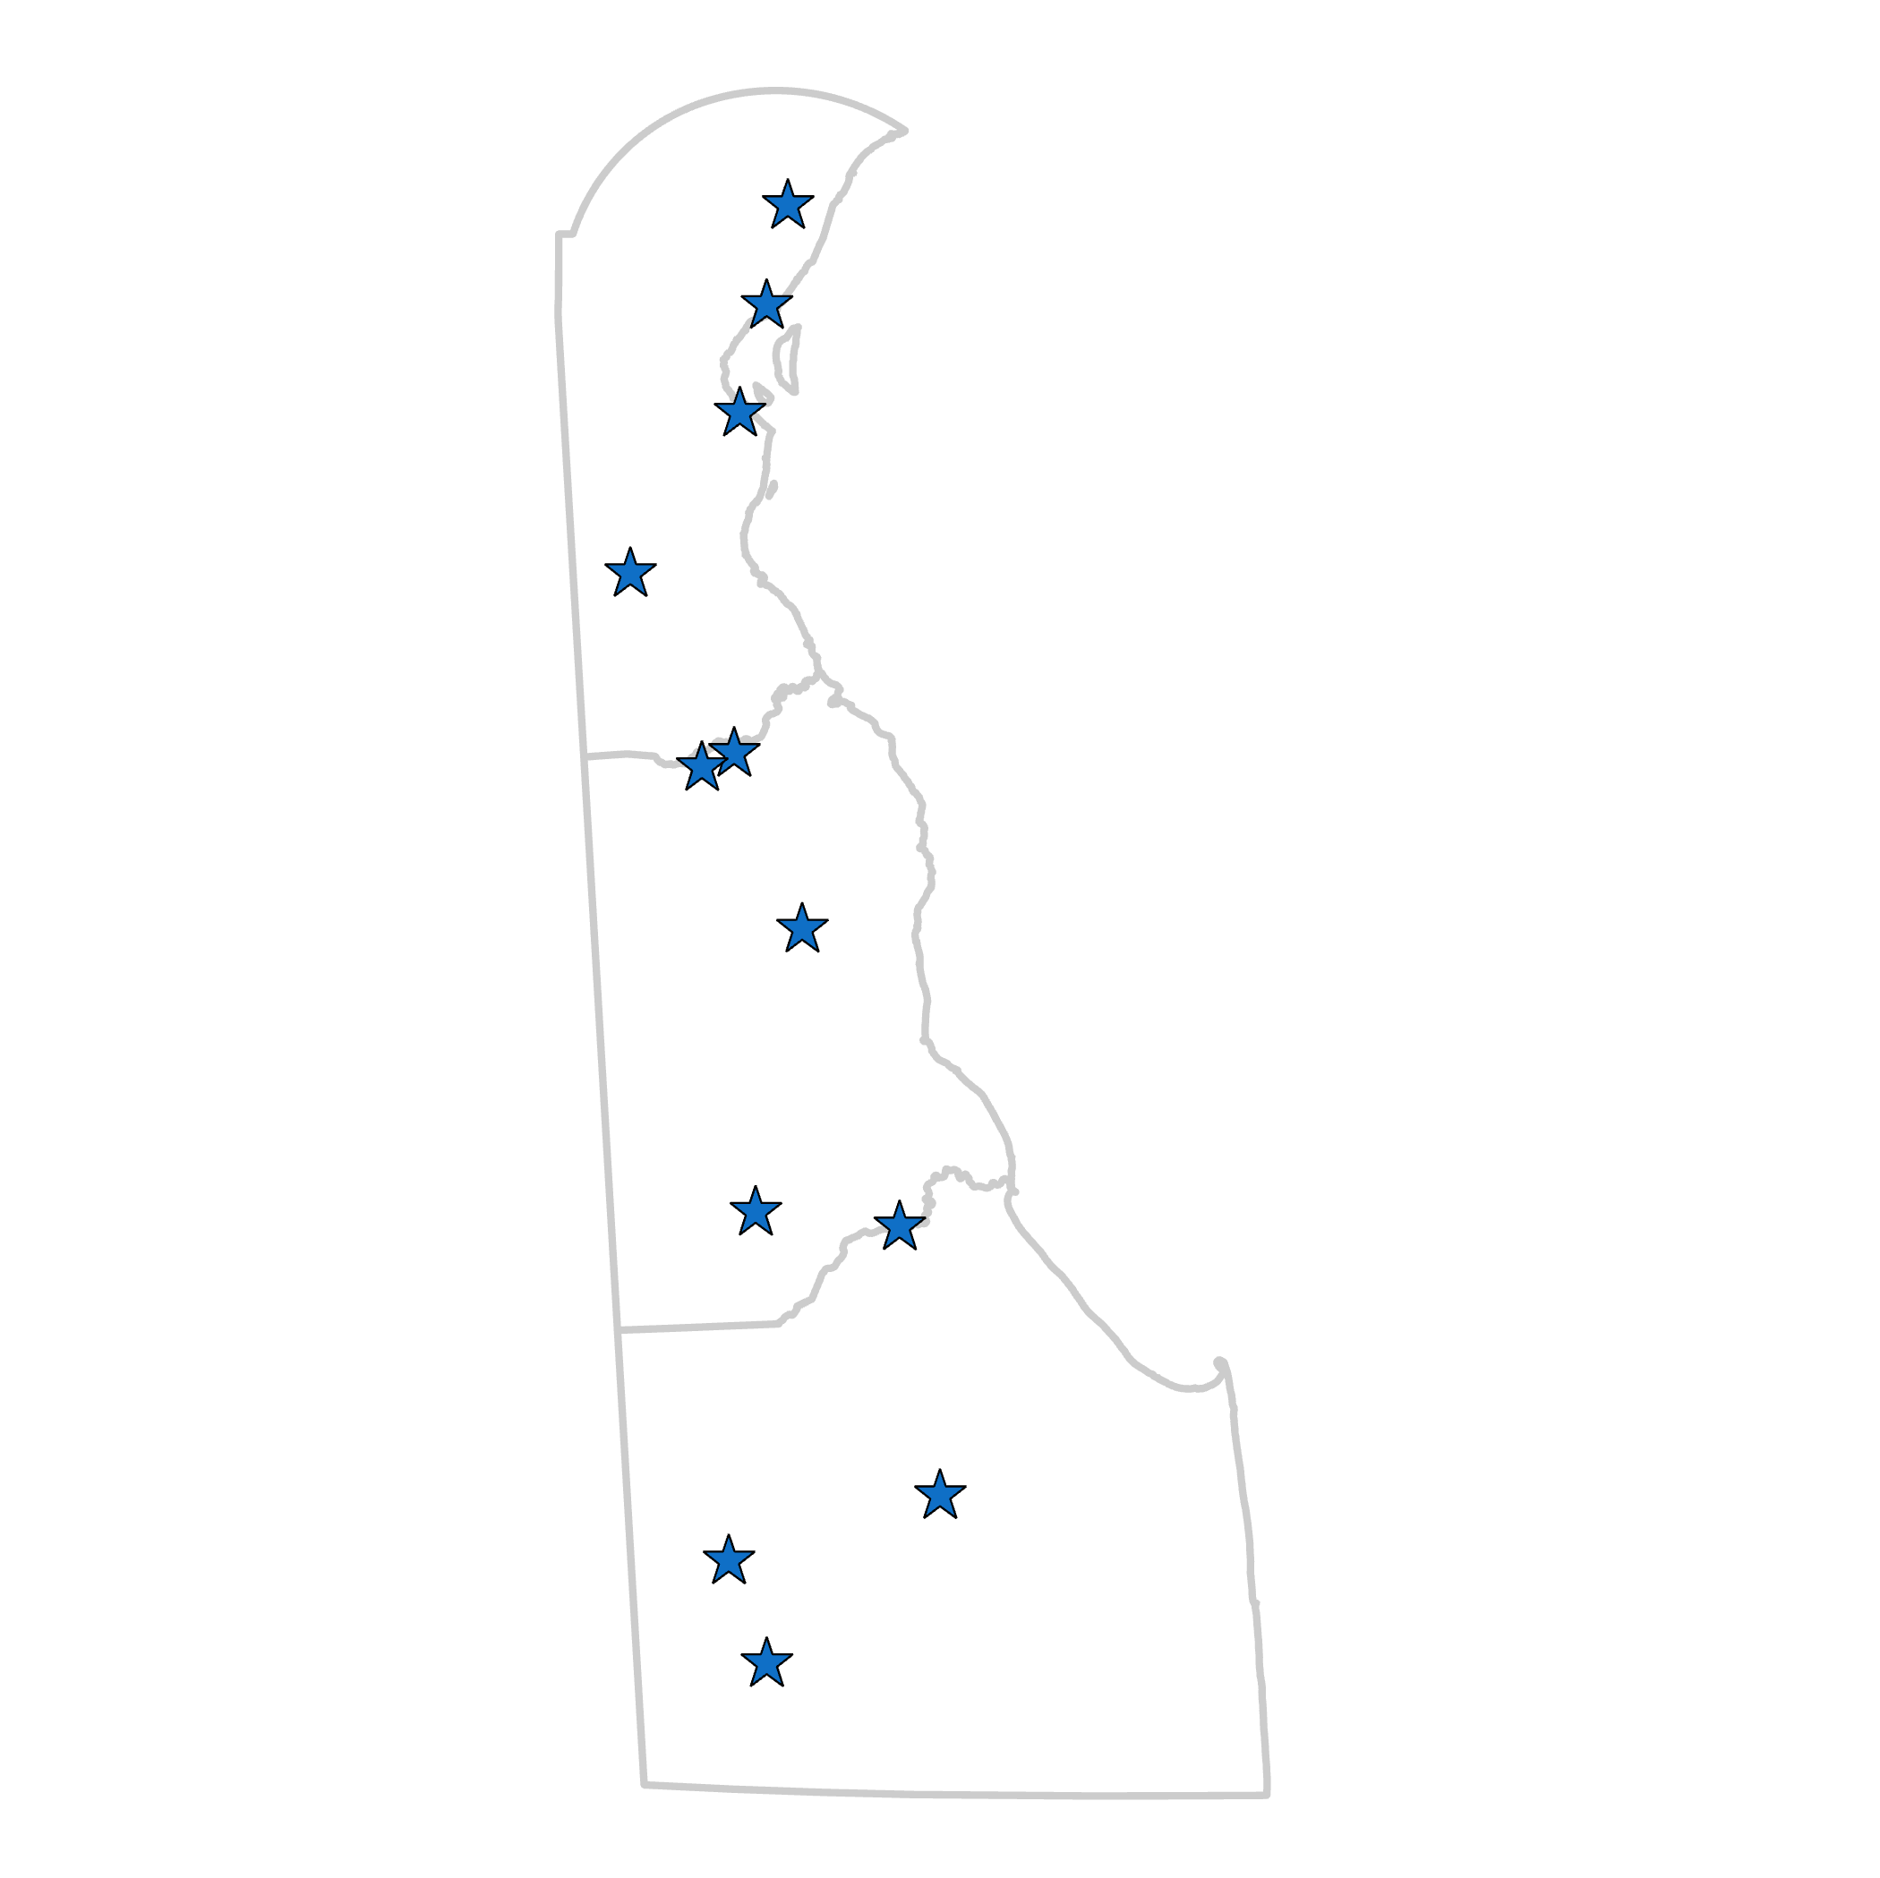
DOWNTOWN DEVELOPMENT DISTRICTS
2015
Wilmington
Dover
Seaford
2016
Smyrna
Harrington
Milford
Georgetown
Laurel
2019
Clayton
Delaware City
Middletown
New Castle
Notes:
There are 12 districts throughout the state. These jurisdictions have applied and been accepted by the DDD program.
The first districts, designated in 2015 are approaching their 10-year deadline for renewing their designation for up to 2 more 5-year terms. DSHA working with the Office of State Planning Coordination to provide a renewal application process. First three districts were Wilmington, Dover, Seaford
Under the initial legislation, the program can allow for 15 districts.

Slide 9
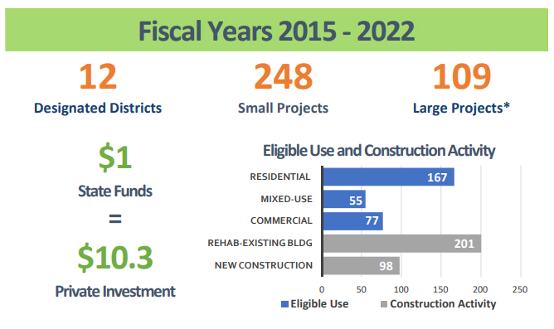
DOWNTOWN DEVELOPMENT DISTRICTS
Notes:
According to the most recent annual report, over 350 projects have been completed since 2014.
Every $1 in state funds equals $10.3 in private investments.
The chart in the bottom right corner displays the types of construction funded and completed.

Slide 10
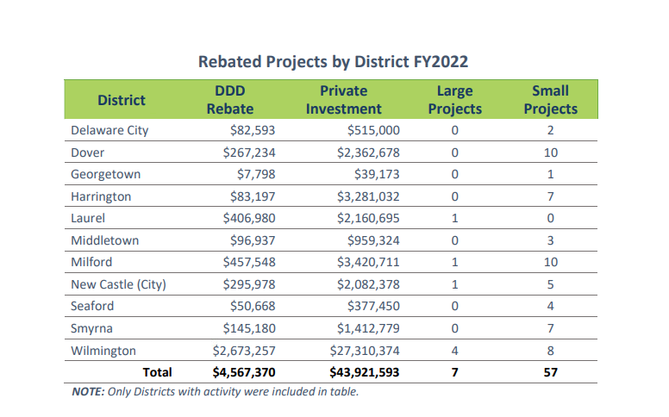
DOWNTOWN DEVELOPMENT DISTRICTS
Notes:
This table demonstrates participation by each district in 2022.
299 projects were completed, using $24 million in state DDD funds to leverage over $356 million in private investment. 58 projects are still under construction.
Over half the projects have been residential, followed by commercial and mixed-use.
The diversity of these projects creates a range of housing opportunities that also lead to a solid customer base for nearby businesses

Slide 11
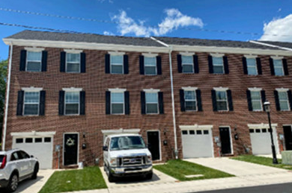
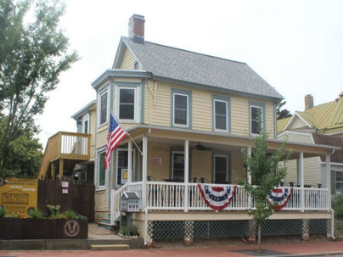
DOWNTOWN DEVELOPMENT DISTRICTS
Transforming Distressed Communities
Ninth Street Holdings LLC - New Castle A dilapidated structure, considered a blight on the neighborhood, was demolished and replaced with six townhomes with brick facades.
Repurposing Existing
Buildings
Triple Twelve LLC - Middletown Originally a residence dating back to the 1800s, this building has been renovated into a tasting room and beer garden for a microbrewery. This popular destination is attracting more visitors to Middletown while supporting surrounding businesses.
Notes:
The following slides include examples you might have seen in your neighborhood or downtown area.
In New Castle, a structure considered a blight on the community was demolished and replaced with six townhomes with brick facades.
Down the highway in Middletown, a residence dating back to the 1800s has been renovated into a tasting room and beer garden for a microbrewery. This popular destination is attracting more visitors to Middletown while supporting surrounding businesses.

Slide 12
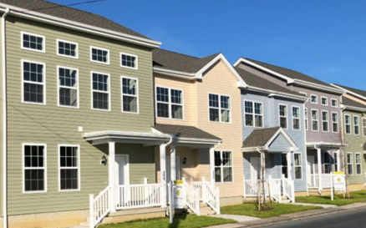
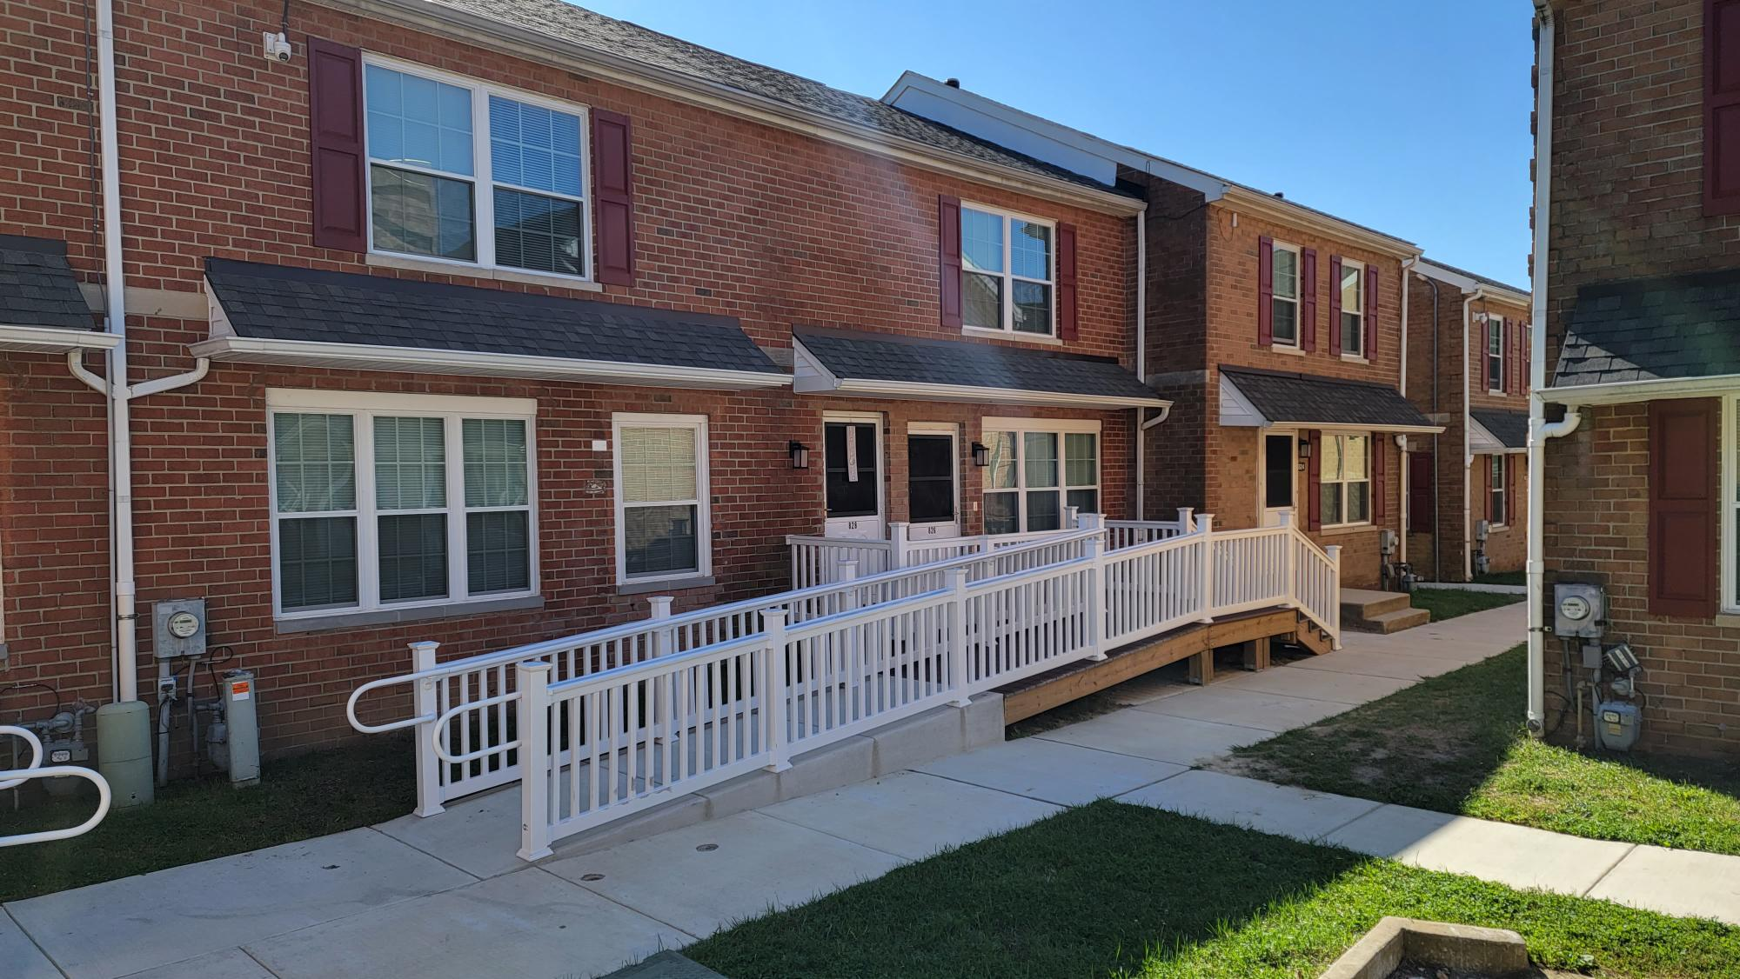
DOWNTOWN DEVELOPMENT DISTRICTS
Sustainable Homeownership
200Front LLC - Milford Long dilapidated structures were demolished over several parcels to construct and design nine affordable townhomes to complement the North Milford Historic District.
Residential Rehabilitation
Compton Towne Preservation Associates, LLC- Wilmington
Renovation of a 75-unit affordable housing complex on the East Side of Wilmington that created new accessibility features and units and helped preserve the existing rental subsidy.
Notes:
Long dilapidated structures were demolished over several parcels in Milford to construct and design nine affordable townhomes to complement the historic district.
In Wilmington, renovating a 75-unit affordable housing complex on the East Side of Wilmington created new accessibility features and units that helped preserve the existing rental subsidy.

Slide 13
DEVELOPING DELAWARE STRONG NEIGHBORHOOD HOUSING FUND (SNHF)
Revolving fund to be used for the acquisition, renovation, and sale of vacant, abandoned, foreclosed, or blighted property
Targeted for efforts that support community development and/or transform neighborhoods
143 units created since the program launched
25 homes created in 2022
44 homes anticipated in 2023
$4,000,000 REQUESTED
Notes:
Our final program and request for today is the Strong Neighborhoods Housing Fund.
This program is a revolving fund used to acquire, renovate, and sell vacant, abandoned, foreclosed, or blighted properties.
Since the program launched, 143 units have been added to the housing stock. We anticipate 44 housing units being completed this year.

Slide 14
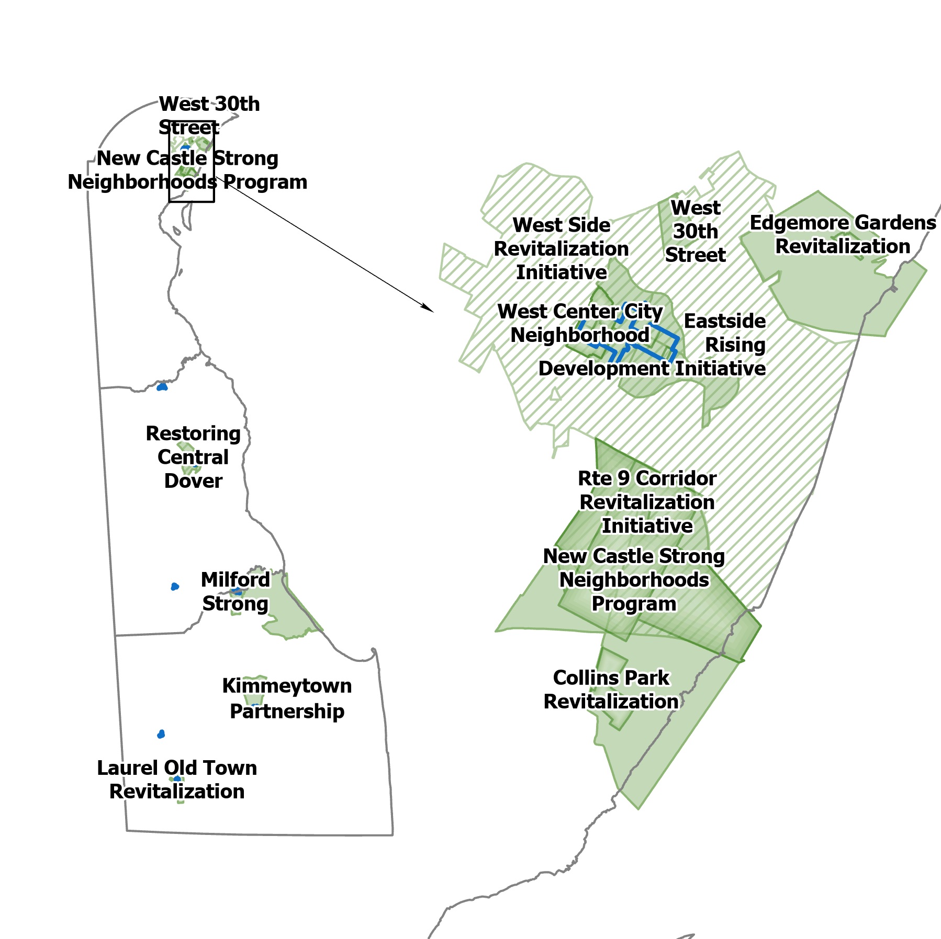
STRONG NEIGHBORHOOD HOUSING FUND (SNHF)
Notes:
This program targets its efforts that support community development and transform neighborhoods. The map on the screen here displays the targeted areas in each county.

Slide 15
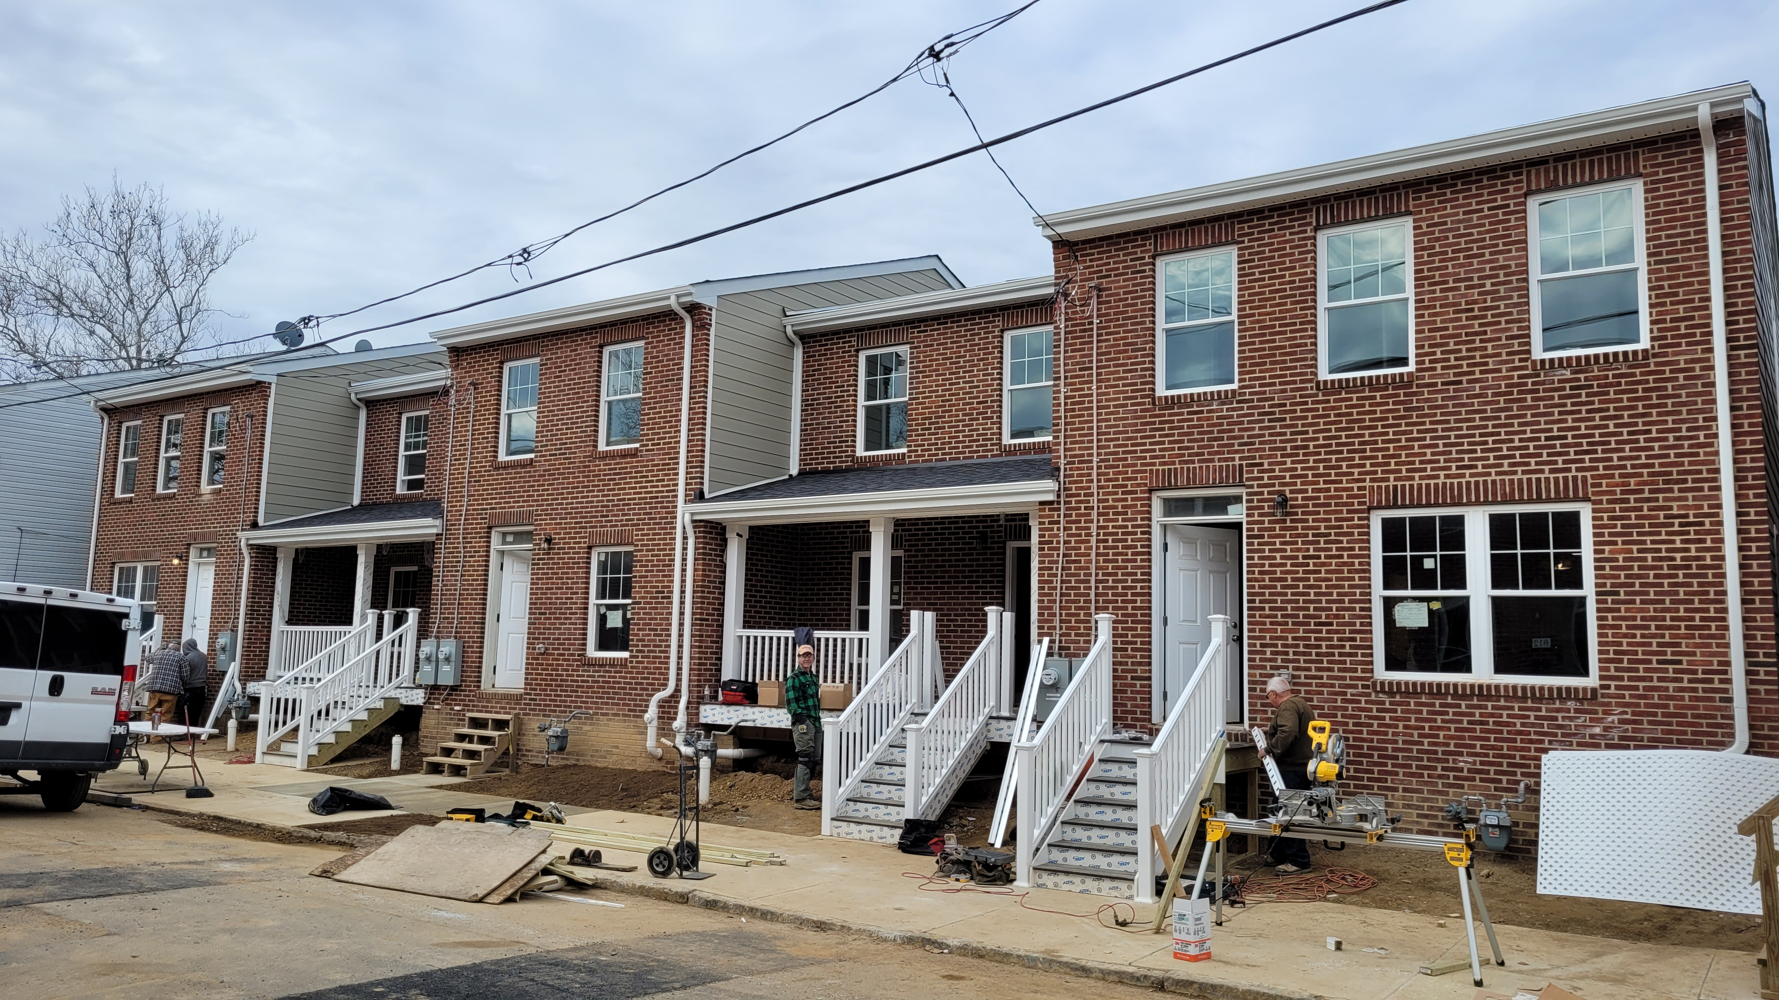
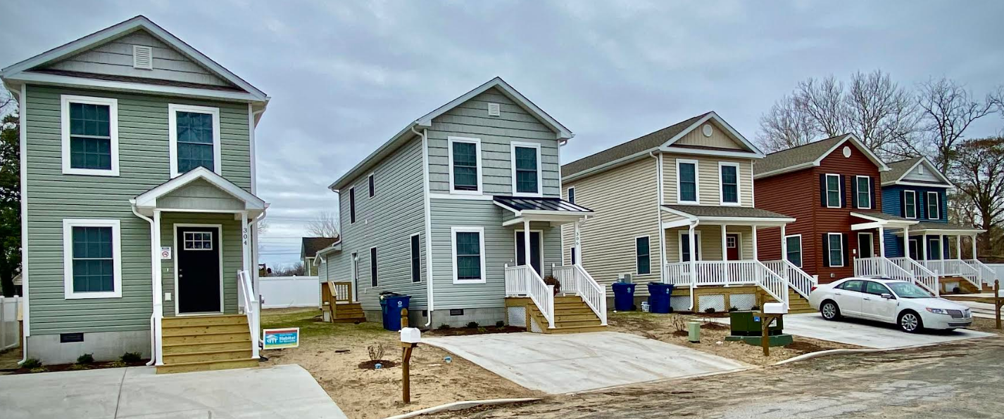
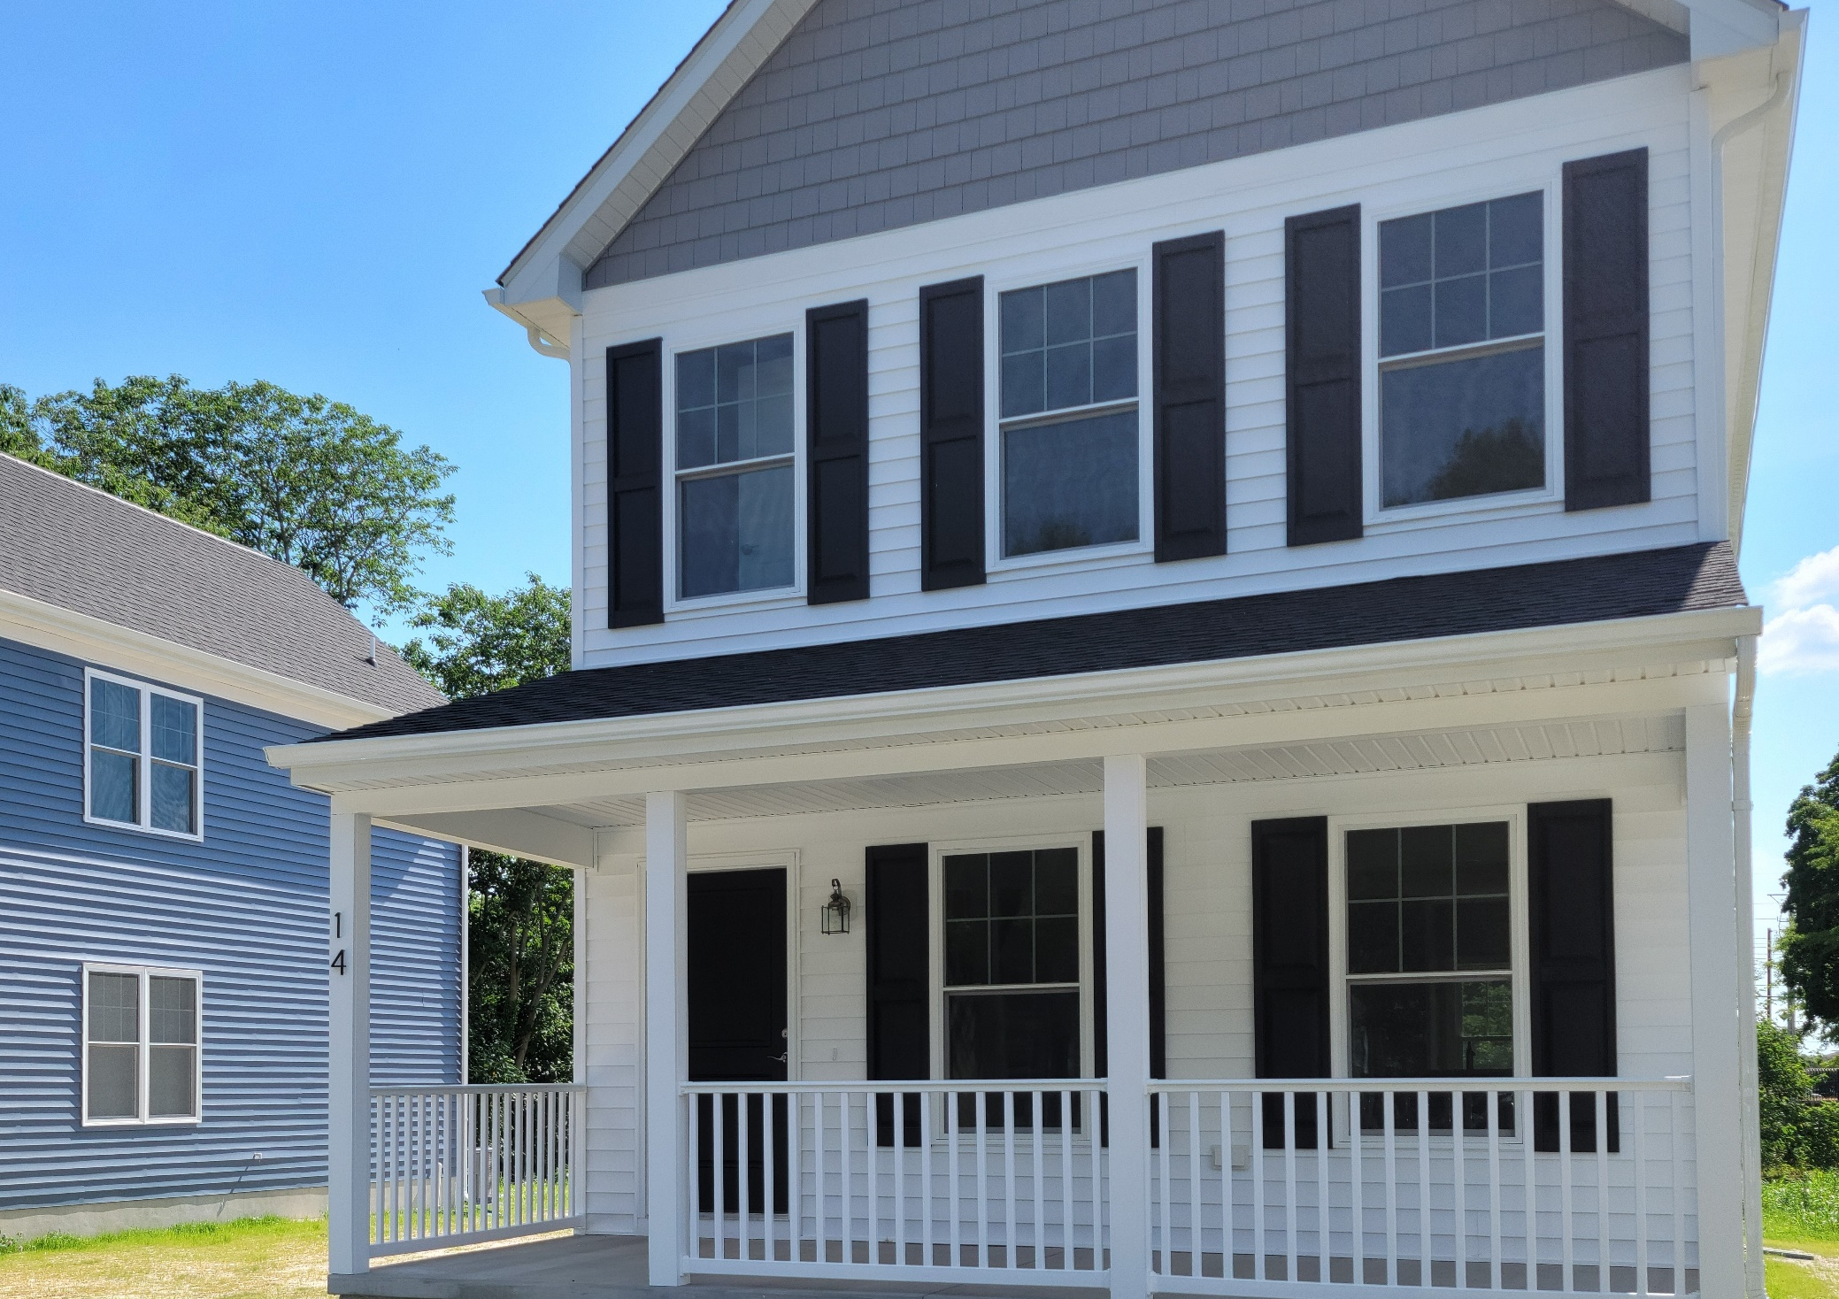
STRONG NEIGHBORHOOD HOUSING FUND (SNHF)
Wilmington
Amala Way, which consists of five new townhomes, resides along the 800 block of Wilmington’s Eastside.
Habitat for Humanity of New Castle County brought this project to life.
Laurel
Hope Hill is located on West Front Street.
Four units are completed, and one is still underway.
Dover
Located on South Queen Street, this 3 bedroom/2.5 bath has been occupied since 2021
Neighborgood Partners, formerly NCALL, developed the project.
Notes:
We have some excellent homeownership examples to share with you today.
Amala Way, which consists of five new townhomes, resides along the 800 block of Wilmington’s Eastside. Habitat for Humanity of New Castle County brought this project to life using the Strong Neighborhoods Housing Fund.
Hope Hill is located on West Front Street in Laurel. Four units are completed, and one is still underway.
Located on South Queen Street, Dover, this 3 bedroom/2.5 bath has been occupied since 2021. Neighborgood Partners, formerly NCALL, developed the project again using a Strong Neighborhoods Housing Fund investment.

Slide 16
SUMMARY OF BUDGET REQUEST
General Fund:
Housing Development Fund | $4,000,000
State Rental Assistance Program | $4,000,000
Total General Fund: | $8,000,000
Bond Bill:
Affordable Rental Housing Program | $6,000,000
Downtown Development Districts | $5,500,000
Strong Neighborhoods Housing Fund | $4,000,000
Total Bond Bill: | $15,500,000
DSHA Budget Request | $23,500,000
*Not inclusive of one-time $30,000,000 supplement
Notes:
These three programs make up our Fiscal Year 2024 Capital Improvement budget request. To date, and as evidenced by this presentation, these programs have been incredibly instrumental in developing affordable housing around Delaware.
We are eager to continue receiving this funding and using these dollars to aid the people of our state for years to come.
It is important to note that this request for $15.5 million will continue to be supplemented by the many millions in federal funding received from COVID Relief, ARPA investments, and one-time supplemental dollars.

Slide 17
AMERICAN RESCUE PLAN ACT
DSHA received $60.2 million in State and Local Fiscal Recovery Funds (SLFRF) authorized by the American Rescue Plan Act (ARPA) from the State of Delaware. These dollars will be used to fund five programs related to economic development and affordable housing programs:
Catalyst Fund
$20 Million
Accelerator Fund
$15.5 Million
Preservation Fund
$15.5 Million
Market Pressure Relief Fund
$9 Million
Tenant Rent
Reporting Pilot
$200,000
Notes:
Last summer Governor Carney announced $60.2 million for housing initiatives, which was allocated to DSHA to administer. These funds were made available to DSHA in November of 2022.
With this funding, our team has created a handful of new innovative and ambitious housing programs to build upon the financing, and supportive efforts mentioned previously.
The four programs are as follows:
Catalyst Fund, designed to create affordable homeownership opportunities through the acquisition and rehabilitation of vacant homes
Accelerator Fund, designed to incentivize market-rate developers to provide affordable rental housing in planned construction projects
Preservation Fund, designed to ensure nearly 1,000 existing affordable rental units remain affordable
Marketing Pressure Relief Fund, designed to relieve economic cost pressures faced by affordable housing developers. The award is structured as a loan to the owner, deferred for 30 years at 1% interest. The application deadline closed on last month, and approximately $4 million in assistance was requested. We’re evaluating ways to help even more affordable construction projects using the remaining funds.
Rent Reporting Pilot Program:
Aims to help up to 400 low-income renters increase their credit scores by reporting their reliable rental payment history. Most rental payment history is never reported to the larger credit reporting bureaus. Without this information, renters’ credit scores do not reflect their actual credit risk. This unreported positive payment history can be a significant factor in decreasing economic mobility.
DSHA is partnering with Self Financial and NeighborGood Partners to execute the program, which launched in January.
To participate in the pilot program, renters must have a housing voucher from or live in a public housing unit operated by one of the state’s five PHAs, OR have a household income of at/below 250% of the federal poverty level. For a family of four, that works out to an annual household income of $69,375.
Program participants will receive 12 months of rent and utility reporting, access to monthly credit scores, ID theft insurance, the option to enroll in financial counseling, and the option to report up to 24 months of past rent and utility payments.

Slide 18
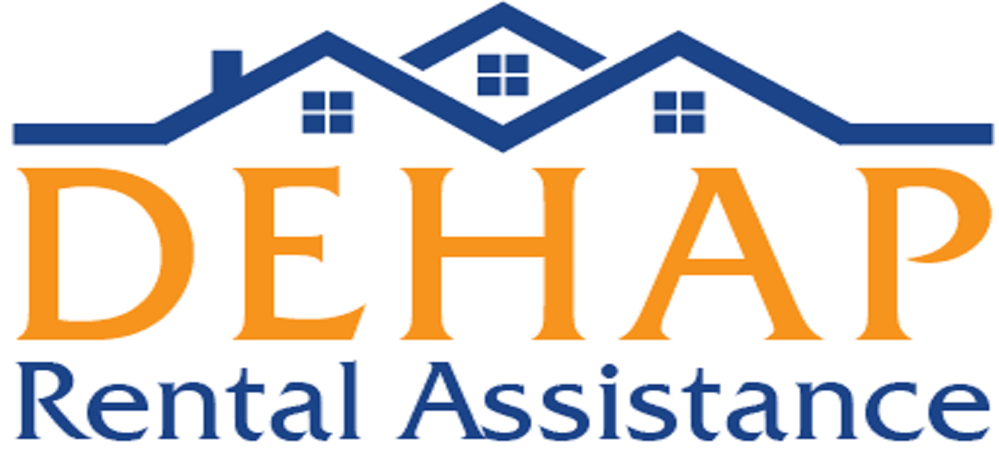
DELAWARE HOUSING ASSISTANCE PROGRAM
Funded through the federal Emergency Rental Assistance Program, which the U.S. Treasury Department distributed to Delaware in January (ERA-1) and May 2021 (ERA-2).
Funding from ERA-1 expired in September 2022 and ERA-2 funds have been depleted.
DEHAP is no longer accepting applications unless submitted by a community navigator.
Community navigators can assist with evictions and utility shut-offs.
Tenant Rent
Reporting Pilot
$200,000
Notes:
Last but not least is our DEHAP program, which is closed and will remain closed to new applications. Those facing eviction and utility shut-off can still receive assistance through a community navigator.
Cases (approximations):
Kent (16%) = 4052
New Castle (77%) = 19501
Sussex (7%) = 1773
Funds Disbursed (approximations):
Kent (16%) = $21,479,770
New Castle (78%) = $104,713,881
Sussex (6%) = $8,054,914
ERA, the U.S. Treasury funding source, has also allowed the agency to branch out into various eviction defense and tenant assistance programs, which we are thrilled to know will continue until 2025.

Slide 19
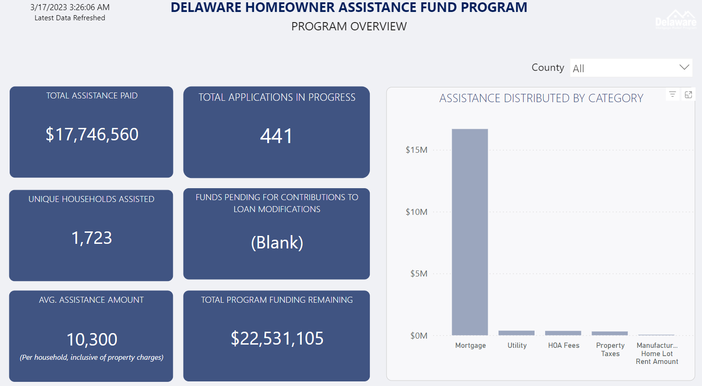
DELAWARE MORTGAGE RELIEF PROGRAM
DSHA received $50 million in Homeowner Assistance Funds from the U.S. Treasury Department. These dollars are being used to assist Delawareans facing foreclosure or mortgage delinquency.
Catalyst Fund
$20 Million
Accelerator Fund
$15.5 Million
Market Pressure Relief Fund
$9 Million
Tenant Rent
Reporting Pilot
$200,000
Notes:
Last summer, the agency launched the Delaware Mortgage Relief Program using $50 million received from the U.S. Treasury Department.
This program aims to support homeowners at risk of foreclosure or mortgage delinquency due to the COVID-19 pandemic.
In January, we made updates to the program, which include the following:
Removing the requirement that a homeowner be delinquent by at least 30-days. Homeowners who do not have a delinquent mortgage are now eligible to apply for the program
Offering future monthly mortgage payment assistance for up to 6 months in addition to mortgage reinstatement or imminent risk of delinquency.
Increasing the total assistance amount available from $40,000 to $50,000 per household
In addition to expanding the program, the Delaware Mortgage Relief Program is proud to partner with local housing and legal aid organizations to provide application assistance and ongoing financial planning support for homeowners in need.
The program has since saved the homes of Delawareans throughout the state. Pictured is our public dashboard. It tracks program metrics, including a breakdown by county, race, etc. It is updated daily and available on the program website.
As of Monday, March 20:
$18 million has been paid to over 1,700 households
The average assistance amount is $10,000
Per county:
22% of applications originate from Kent
64% of applications originate from New Castle County
12% of applications originate from Sussex

Slide 20
Eugene R. Young, Jr., Director
18 The Green
Dover, DE 19901
888.363.8808
www.destatehousing.com
Notes:
Great work is happening at DSHA every day and we are actively working to keep you as well as the residents of our state informed about what’s on the horizon. We do not take these investments lightly and are committed to stewarding them with transparency, effectiveness and impact.
DSHA is dedicated to developing affordable housing in Delaware so the community is heard, respected, and valued. We aim to ensure that Delawareans have a safe home of their choosing. Thank you again for the opportunity to address DSHA's main initiatives and budget request for the Fiscal Year 2024.

