Slide 1


Joint Capital Improvement
Committee
March 24, 2023

Slide 2

Notes:
See Talking Points doc for detail
NOTE: does not mean 100% over, as in the case of ongoing sensitivity training, we recognize this is not one and done

Slide 3

Action Items Completed
Deputy Chief Joi Simmons was named Sexual Assault Awareness Officer.
Increased overnight security presence on the Main Campus and DSU Downtown.
Implemented 24/7 escort service.
Reinstated 100% ID checks at the main gate after 5:00 PM.
Assessed and verified 90 plus percent of our 1000+ external lights on campus are operational.
Assessed and verified 100% of all residence hall external doors are operational.
Extended hours of campus counseling center (M-F 8:30 am – 7:00 PM, Sat. 9:00 am -12:00 pm) and health center (M-F 8:30 am – 7:00 pm).
Added virtual health services and behavioral health talk therapy through ChristianaCare - GoHealth Urgent Care.
Established Safe Space Coalition.
Secured a $300k grant to support the establishment of the Safe Space Coalition (National Organization of Sisters of Color Ending Sexual Assault).
Notes:
See Talking Points doc for detail
NOTE: does not mean 100% over, as in the case of ongoing sensitivity training, we recognize this is not one and done

Slide 4
Action Items Underway
Enhancing camera utilization across campus (500+ external cameras are operational).
Providing Body Cameras to all Uniform Police Officers.
Confirming that all emergency blue lights have been assessed; replacements and repairs will be complete within 90-120 days.
Providing University-wide sensitivity training.
Establishing a Center for Safety & Well-being.
April 25, 2023 Sexual Assault Awareness & Violence Prevention Conference. Free of charge and open to the public.
UNIVERSITY INITIATIVES
Notes:
See talking points doc for detail & notes

Slide 5
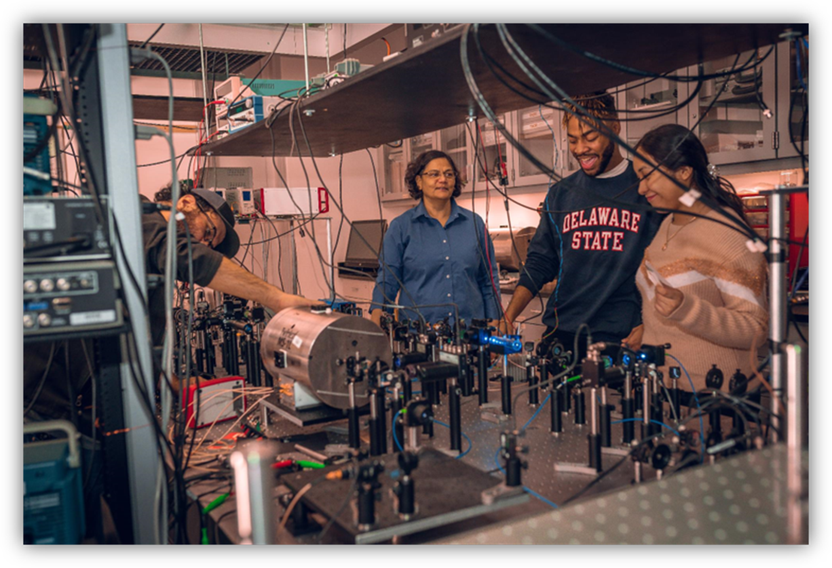
The community of historically Black colleges & universities
HBCUs represent just 3% of all higher education institutions in the United States.
Nearly 20% of Black graduates in the United States.
HBCUs have graduated 40% of all Black engineers; 40% of all Black US Congress members; 50% of all Black lawyers; and 80% of all Black judges.
HBCUs also supply more Black applicants to medical schools than non-HBCU institutions.
Delaware State University is now the #1 choice for students of color in Delaware.

Slide 6
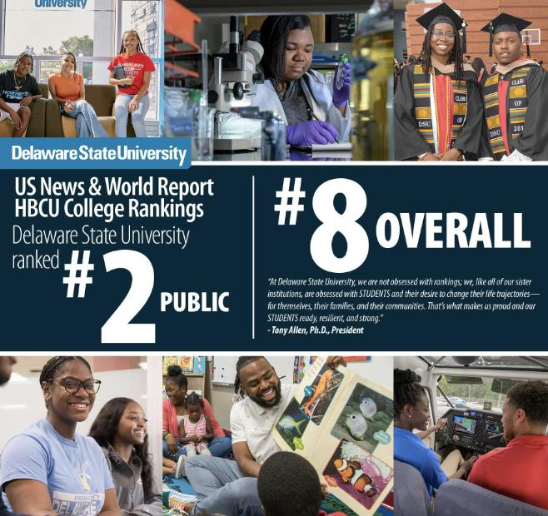
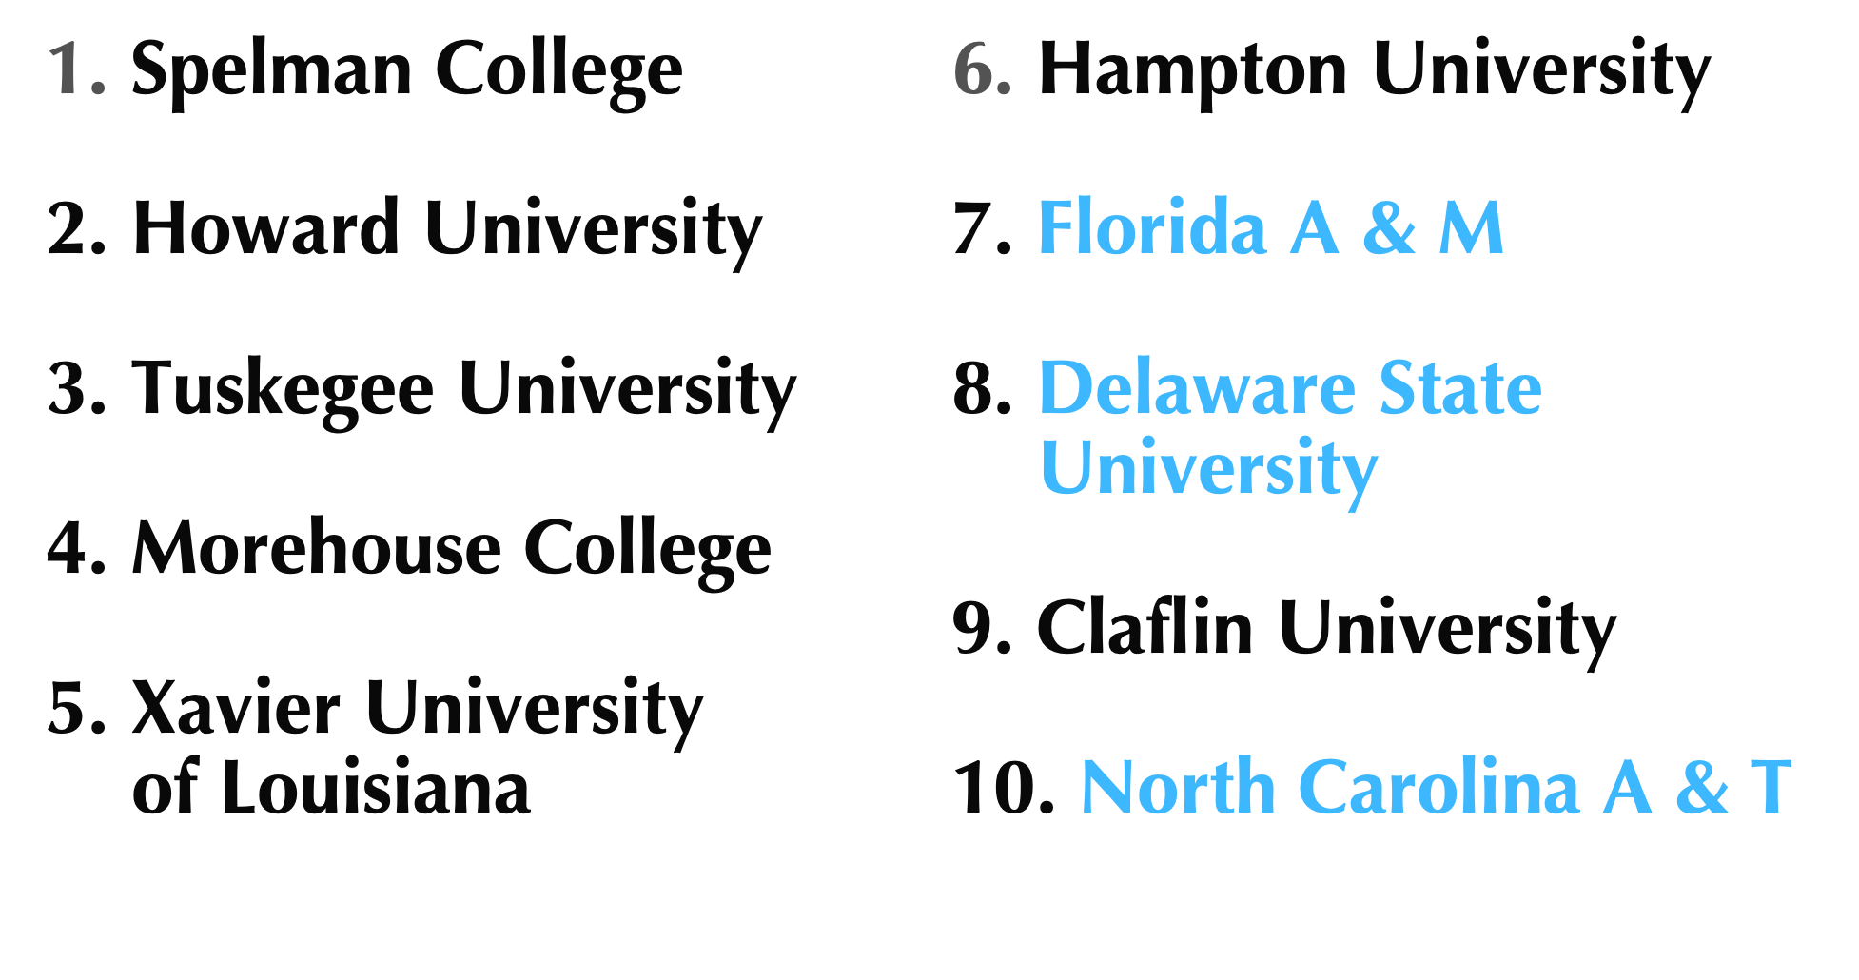
Building upon our solid foundation
U.S. News & World Re
U.S. News & World Report HBCU Rankings
Note: Highlighted HBCUs are public institutions.

Slide 7
Our record-setting enrollment
HISTORIC 5-YEAR GROWTH: 2018-2022
TOTAL ENROLLMENT: up 33%
INSPIRE SCHOLARS: 2x growth
EARLY COLLEGE SCHOOL GRADUATES ENROLLED: 6x growth

Slide 8
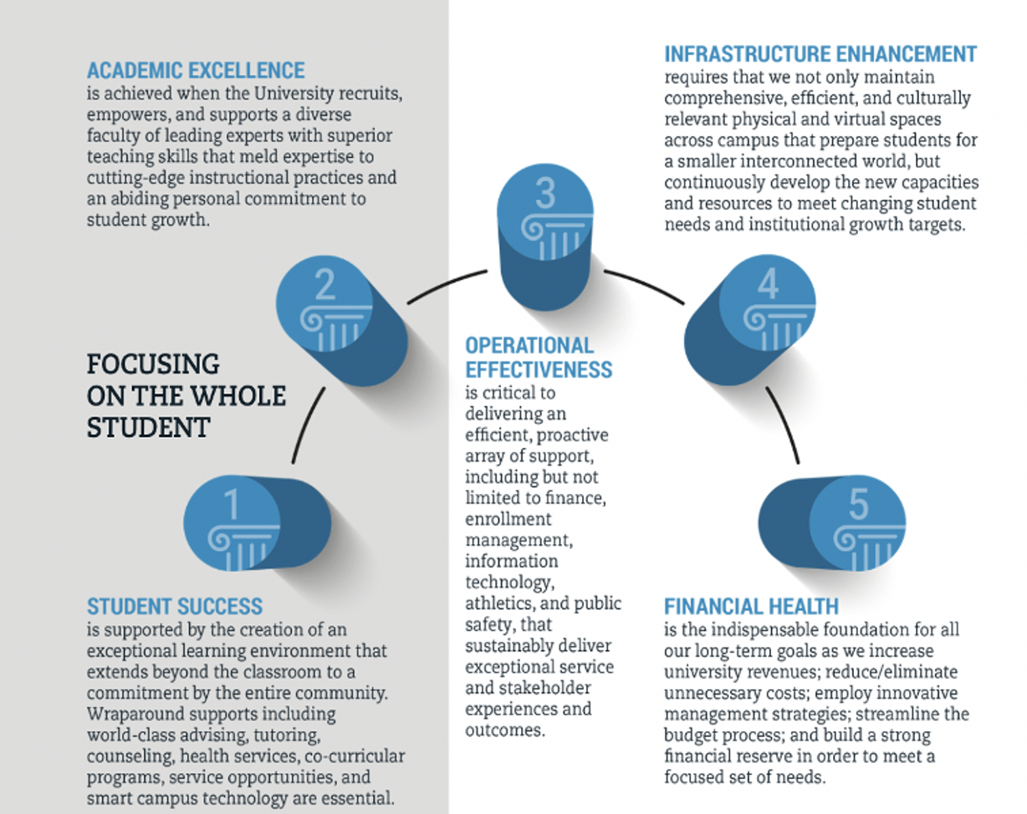
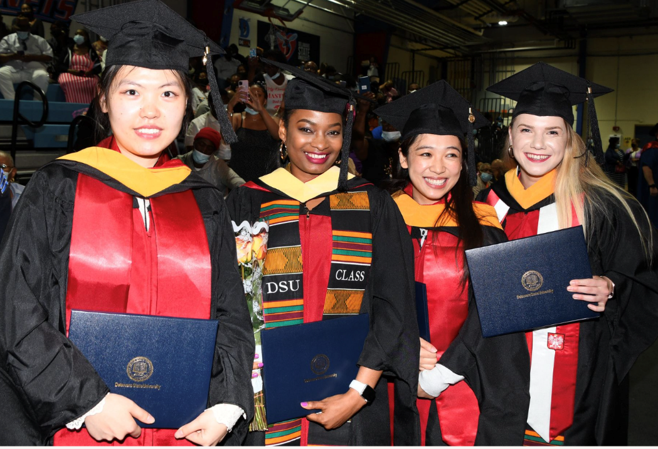
More to come with REACH 2026 emphasizing the whole student

Slide 9





We are seeing growth across key dimensions
Student enrollment metrics
Operating metrics
6,218
Current students as of Fall 2022
8.3%
Increase in operating revenue
75%
Wesley College students retained with 80% graduation rate
41%
Increase in physical footprint and 10% reduction in carbon footprint
7th & 8th graders
Welcomed at Early College Middle School
7%
Increase in total full-time employees
33%
Over five years
10%
Year-over-year from 5,649 in 2021
$18MM
NIH research
grant
$713MM
Economic impact to state of Delaware

Slide 10
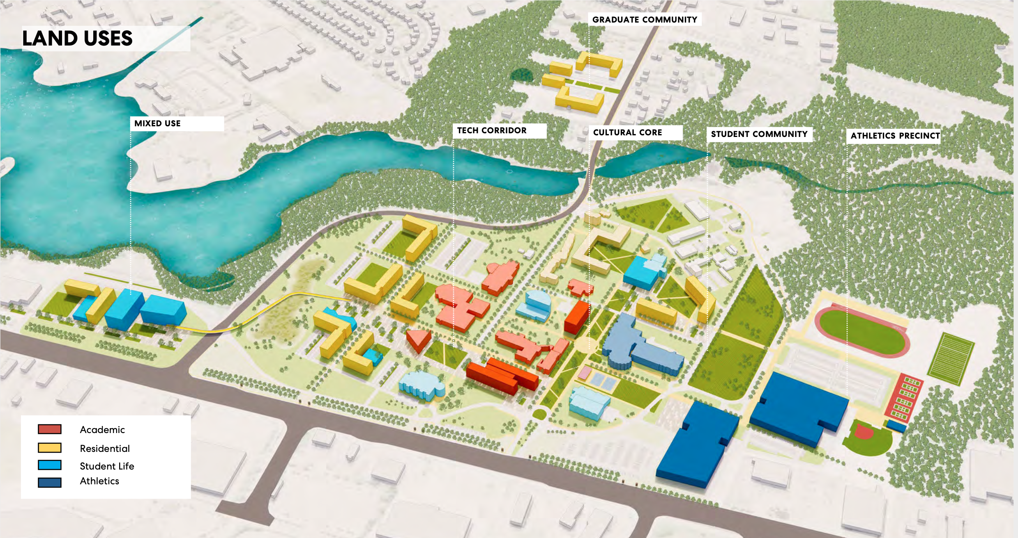
A facilities master plan for America’s most diverse, contemporary HBCU

Slide 11
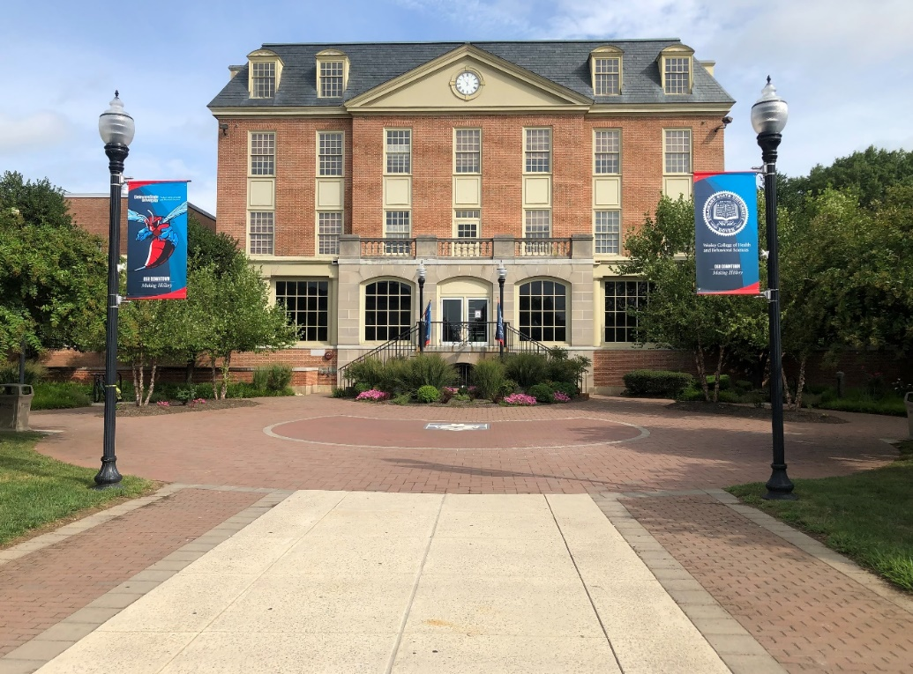
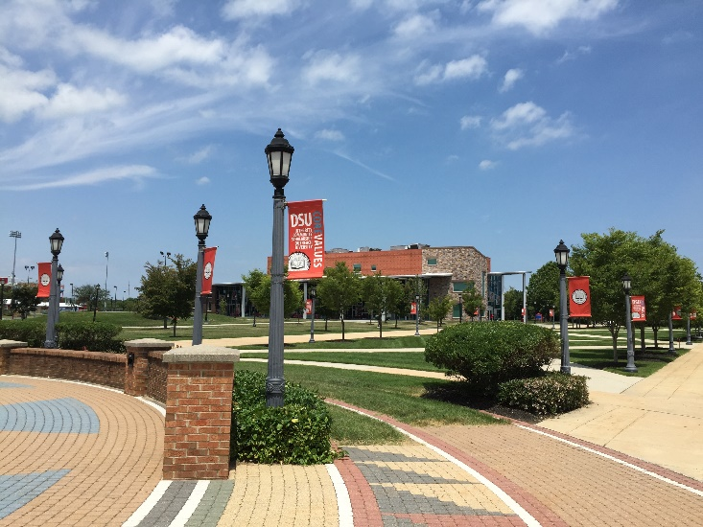
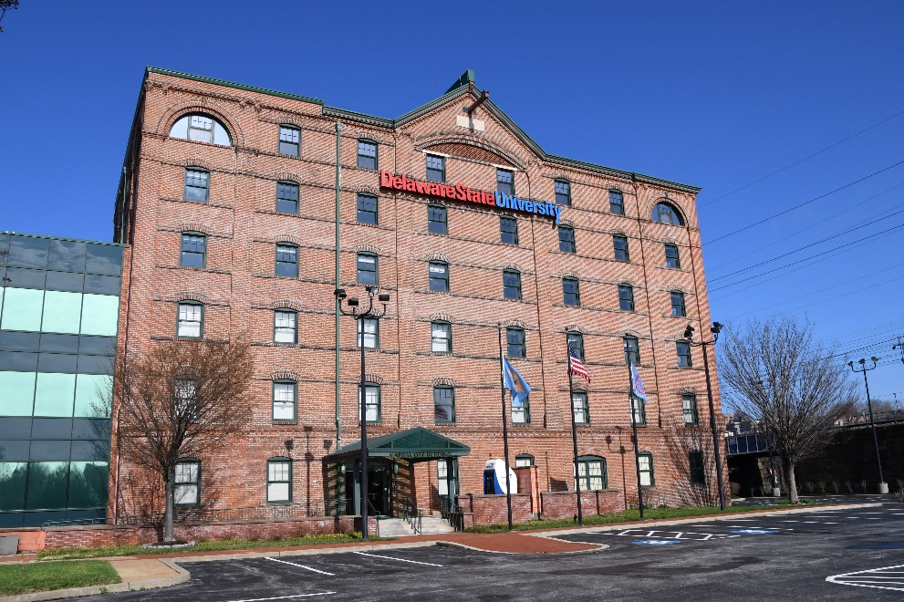
The University’s footprint
1.6MM sq. ft.
73 buildings
640 acres
Dover
Georgetown
Wilmington
Wesley campus
+20 buildings
50 acres
Two farms
Aviation facility

Slide 12
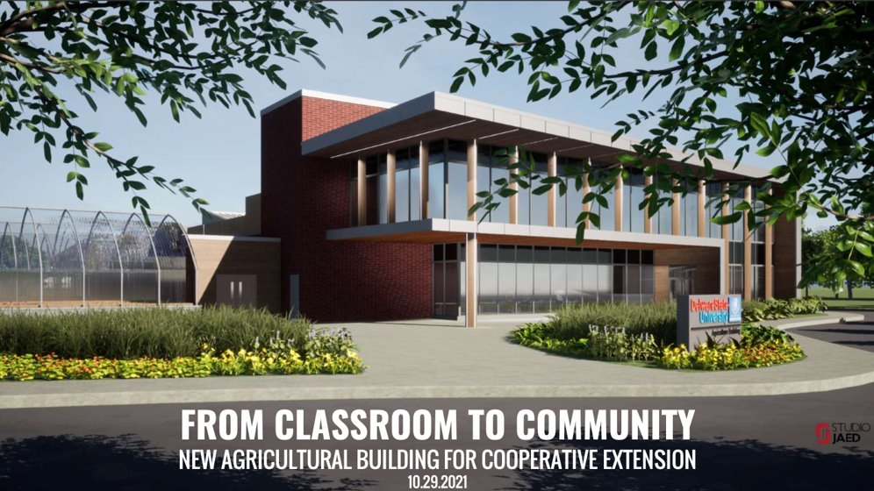
A true public-private partnership

Slide 13
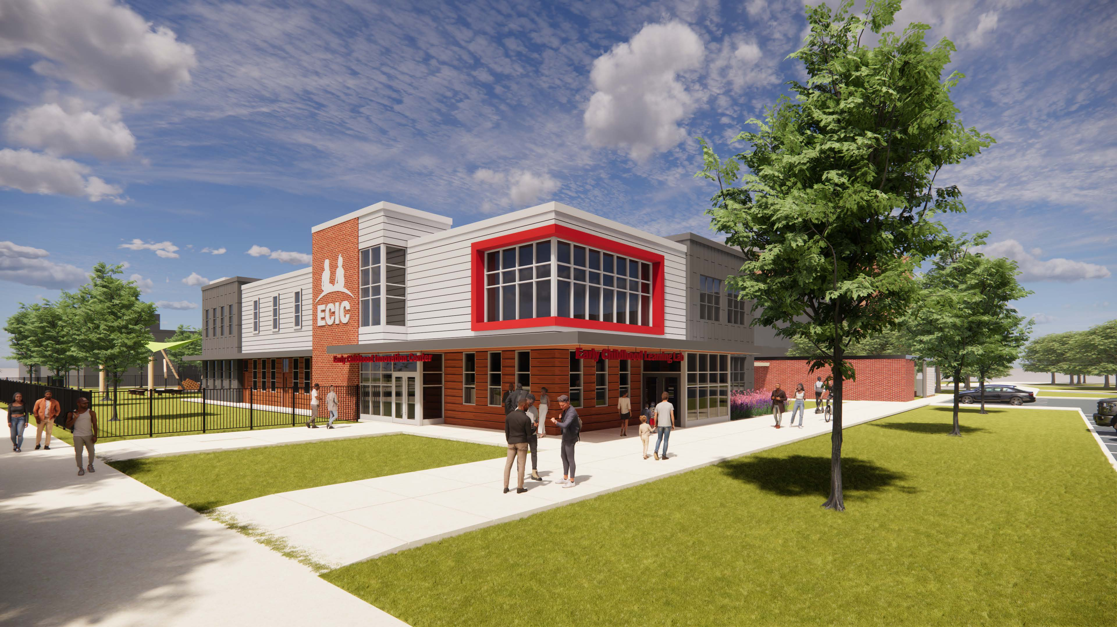
What else is coming? … Early Childhood Innovation Center

Slide 14
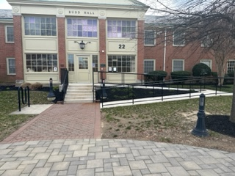
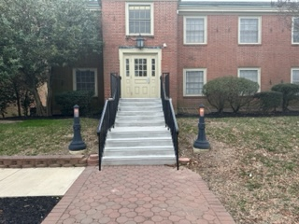
Building a strong foundation
CAMPUSWIDE INITIATIVES ENHANCE CAPACITY AND FUNCTION
(Primary reliance on State-approved vendors/contractors)

Slide 15
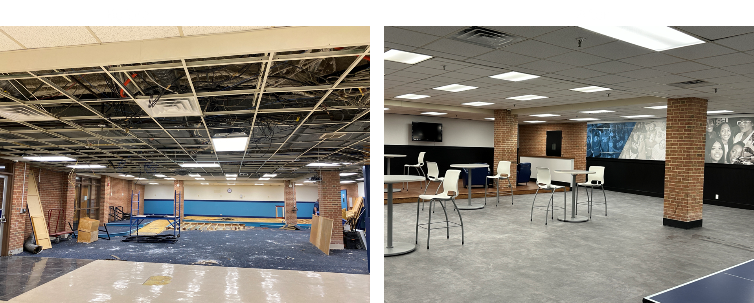
Fostering community and recreation
Before
After
DSU Downtown – Student Center

Slide 16
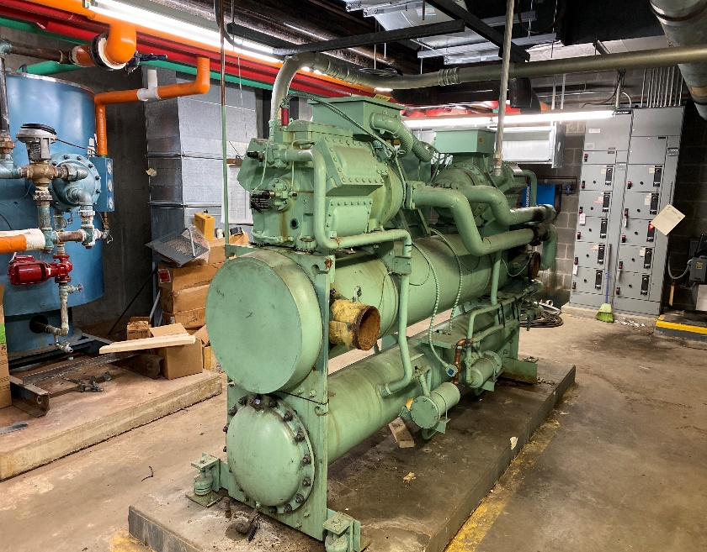
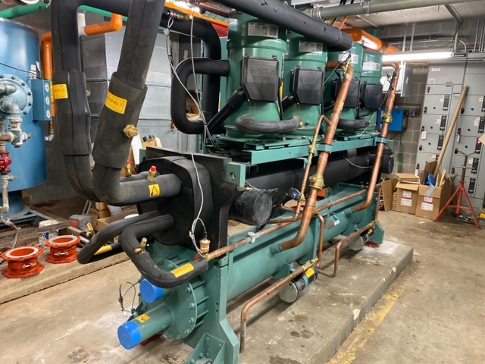
Making critical upgrades, there is more to be done
Before
Boiler Replacements:
Campus-wide
Roofing and flooring projects:
Campus-wide
ADA Renovations:
Campus-wide
HVAC Upgrades:
Campus-wide
Residence Halls Renovations:
Main Campus and DSU Downtown
After

Slide 17
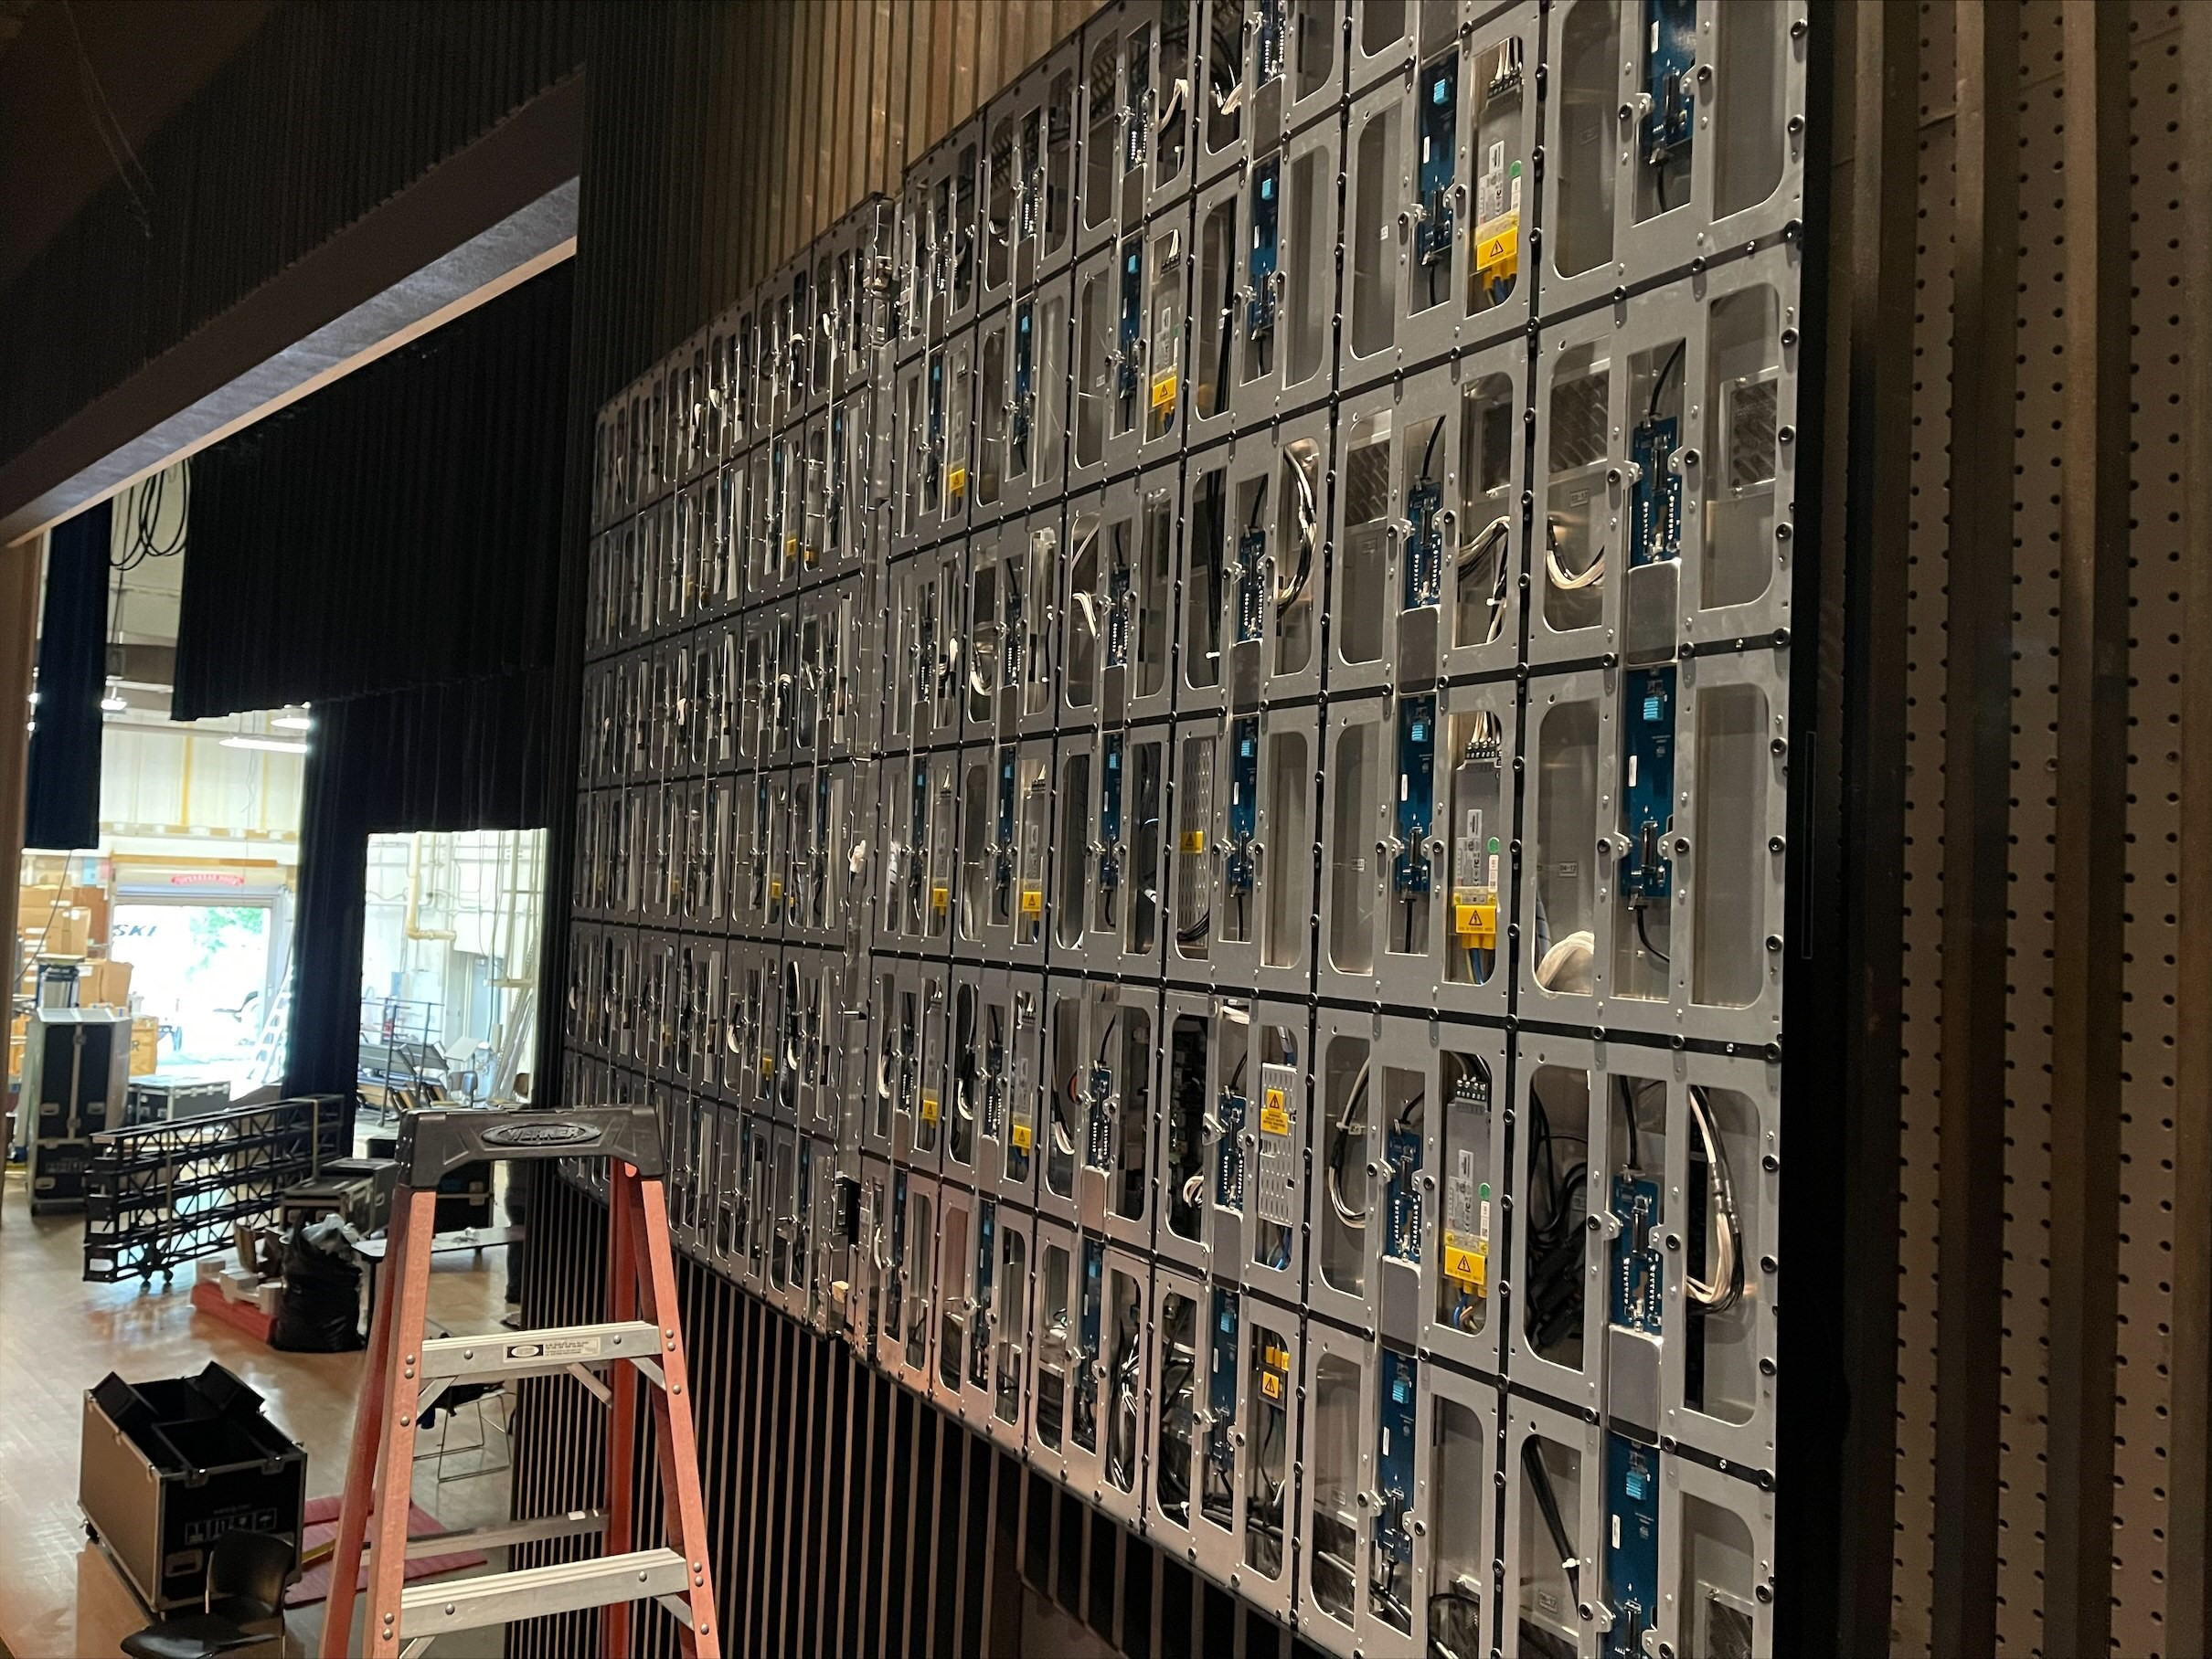
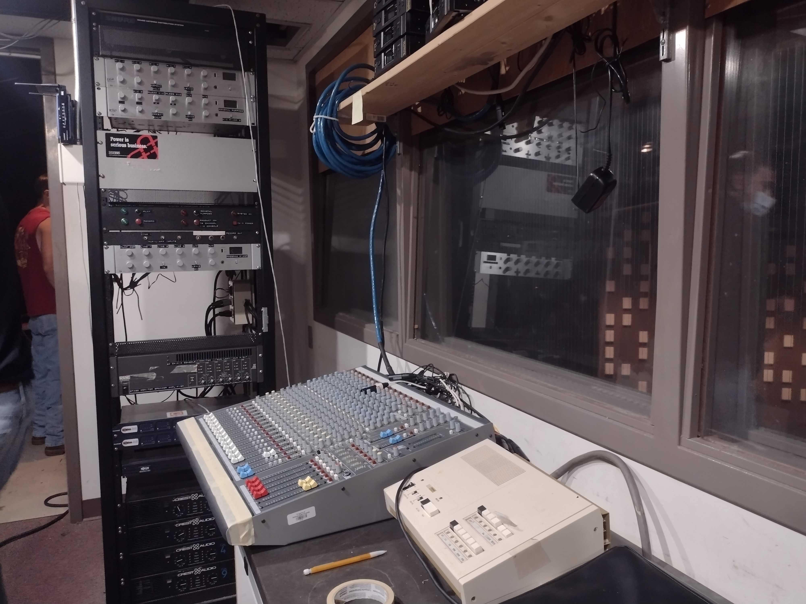
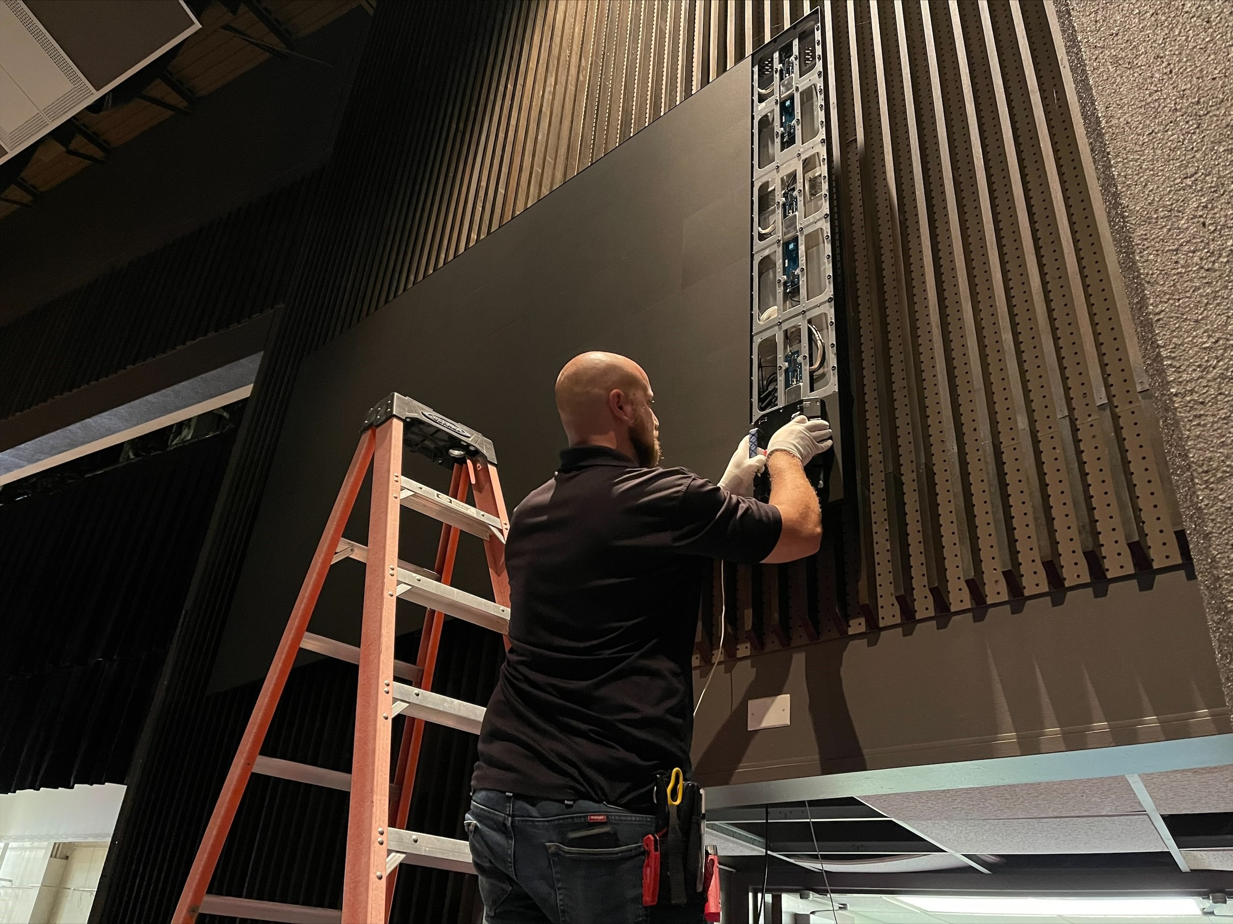
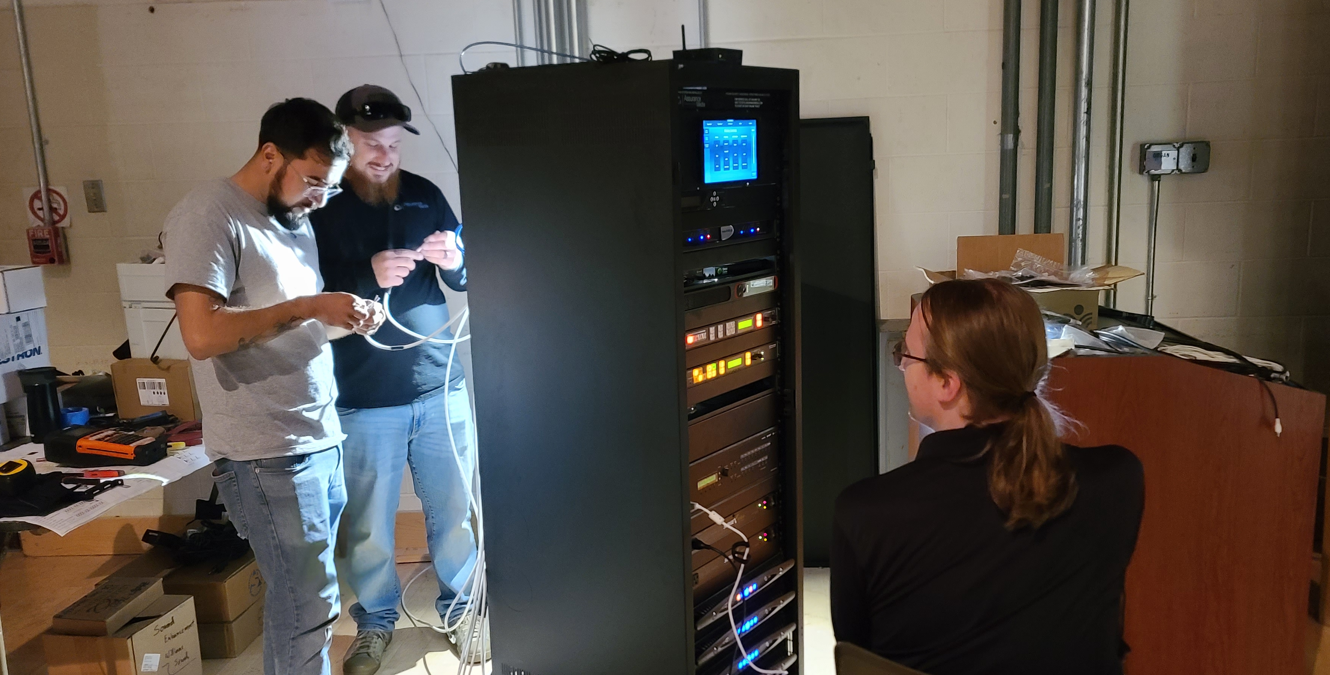
Technology improvements
EH Theatre Technology Upgrades
Cybersecurity Improvement Project
5G Network Updates
Computer Lab and Classroom Technology Upgrades, to include Virtual Labs

Slide 18
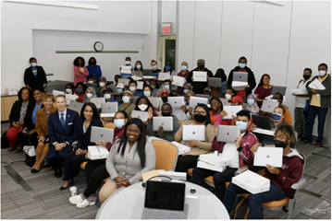
What we need to keep improving and growing
FY 2024 Campus Improvements Request of $25.8 MM:
Renovation of Hope House: $500K
Interdisciplinary Rehabilitation Research Center Old Dover Library: $2.5MM
Deferred Maintenance: $10MM
Aviation Hangar Renovation Project: $5MM
Athletics Transformation: $5MM
Infrastructure Upgrade, Phase II: Wired, and Wireless Networking: $2.8MM

Slide 19




Thank you to our partners who have infrastructure investments

